Slide 1


Modern SharePoint Development Workflow using Node, Bower, Yeoman and more!
Jared Matfess, Solution Architect
Slalom Consulting

Slide 2
Agenda
Who am I?
Modern SharePoint Development
Visual Studio Code
Bower
Gulp
Yeoman
Helpful Resources

Slide 3


Quick Intro
Solution Architect with Slalom Consulting
10+ years in the IT Field
Happily married for 5+ years!
President of CT SharePoint Users Group (www.ctspug.org)
Blog: www.jaredmatfess.com
Twitter: @JaredMatfess
E-mail: JaredM@slalom.com
Slideshare: www.slideshare.net/jmatfess/

Slide 4

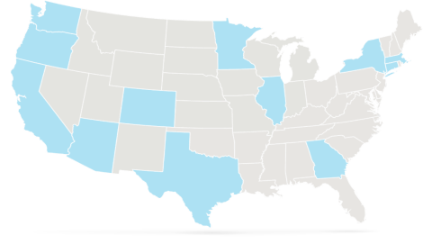





We bring business and technology
expertise to help companies
Improve employee productivity
Improve enterprise performance
Drive innovation
Retain and grow customers
Key Differentiators
Balance of business and technology
National reach – locally based teams
Flexible, client focused delivery
Highly experienced consultants
SEATTLE (HQ)
PORTLAND
MINNEAPOLIS-ST. PAUL
BOSTON
SILICON VALLEY
CHICAGO
HARTFORD
SAN FRANCISCO
DENVER
NEW YORK
LOS ANGELES
PHOENIX
ATLANTA
DALLAS
HOUSTON
LONDON
Management Consulting Firm – Serving our Clients Locally
Founded in
Headquarters
3,000+
National Delivery Centers
13
2001
Seattle, WA
3
Employees Nationally
Years Strong

Slide 5

Who is this session for?
Developers (Beginner/Intermediate)
New to Client Side Development
Not too familiar with Node, Bower, Gulp, etc.
Interested in the new tooling options w/Visual Studio Code

Slide 6
Modern SharePoint Development

Slide 7
What is SharePoint “Development”
Configuration
SharePoint Designer Workflows
InfoPath Forms
Content Query webparts
Content Search webparts
Development
Visual webparts
Server-side code (WSP’s)
Search Display Templates
Anything involving a programming language or scripting language

Slide 8
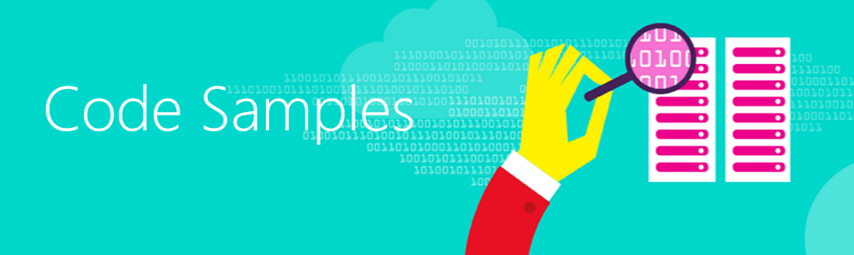
The “State of SharePoint” Development
O365 – Server side code is absolutely not permitted
SharePoint 2016 – server side code is permitted, but discouraged
Microsoft is continuing to invest in “Cloud First” for all new features & functions
Patterns & Practices exist to help transition traditional SSOM solutions to client-side
https://github.com/OfficeDev/PnP
http://dev.office.com/code-samples

Slide 9

Solving for “Build”
The Visual Studio “Build” command includes a whole host of check, compile, deploy cmds
Client-side languages such as JavaScript compile during run-time
A “Build workflow” is needed to improve efficiency for client-side development

Slide 10

Development Options
Reference client-side code in Content Editor Webpart
  Can also bury in a Script Editor Webpart (but that’s terrible)
Develop SharePoint “Add-in” and deploy via App Store
Provider Hosted solution – leverage SharePoint/O365 API’s

Slide 11
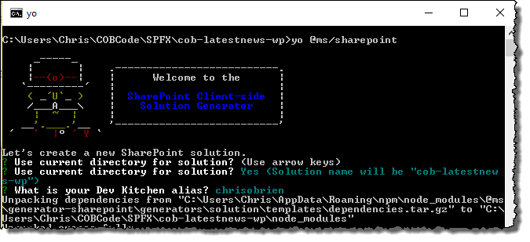
Why should you care?
Microsoft’s new development model (yes, another one!) will be built on these tools
Still client-side development accessing client-side API’s
Credit: Chris O’Brien’s blog

Slide 12
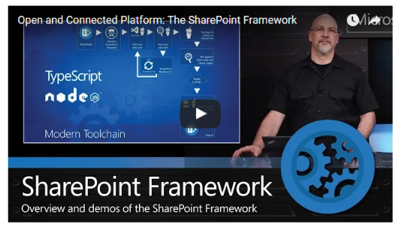
The SharePoint Framework
https://blogs.office.com/2016/05/04/the-sharepoint-framework-an-open-and-connected-platform/

Slide 13

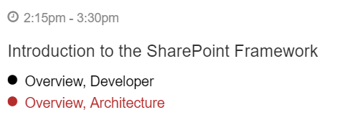
Interested to learn more?
See Bob tomorrow @ SPTechCon!
Tell him Jared sent you! ☺

Slide 14
Visual Studio Code

Slide 15
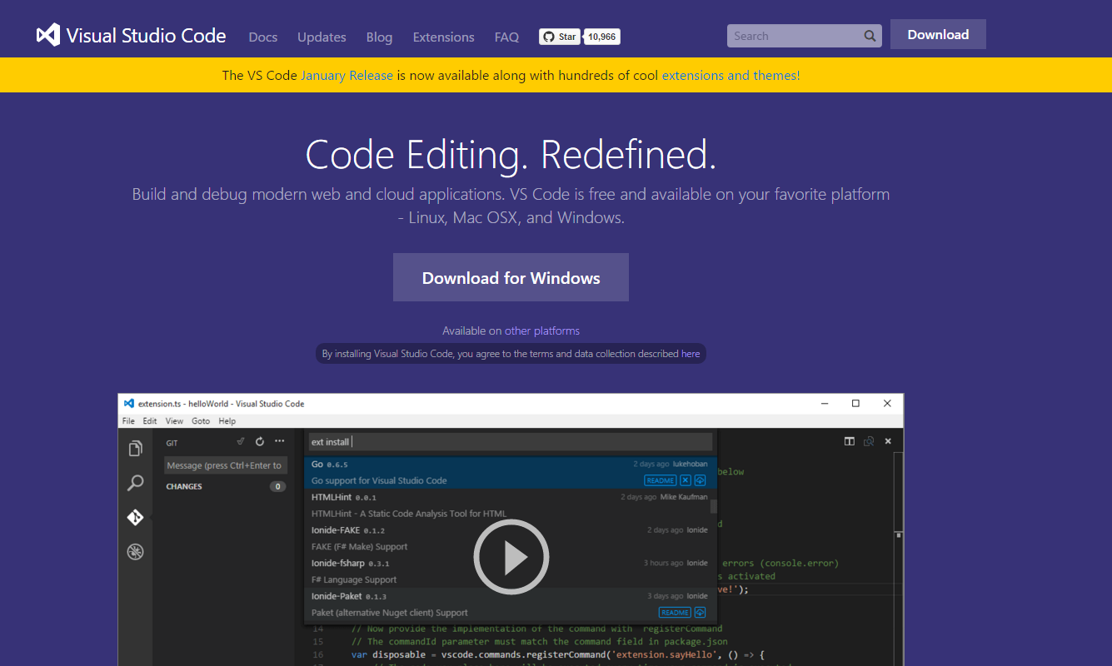
Introduction to Visual Studio Code

Slide 16
Visual Studio Code
Runs on Windows, Mac, and Linux
Not a full IDE, but rather a code editor which allows for a much smaller footprint
Support Intellisense for most popular web languages
Fully customizable to meet your complex development/code needs

Slide 17
Helpful Keyboard Shortcuts
Ctrl + B – toggle the explorer panel
Ctrl + 2 – for performing code reviews you can whiteboard ideas
Ctrl + 4 – zoom in
Ctrl + \ - side by side code editor (you can have up to 3 windows)
Ctrl + Shift + L – multiple cursors (after highlighting a selection)

Slide 18
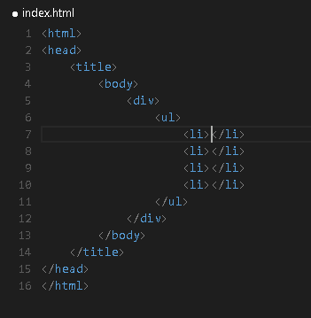

Quick HTML build-out using Emmet
Create a new file, save it as index.html
!>div>ul>li*5 – hit tab and watch it build out your code
http://docs.emmet.io/

Slide 19
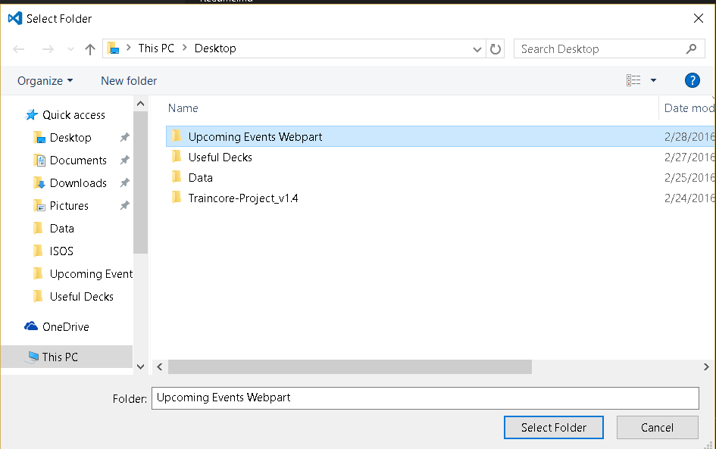
Projects are defined at “Folder” level

Slide 20
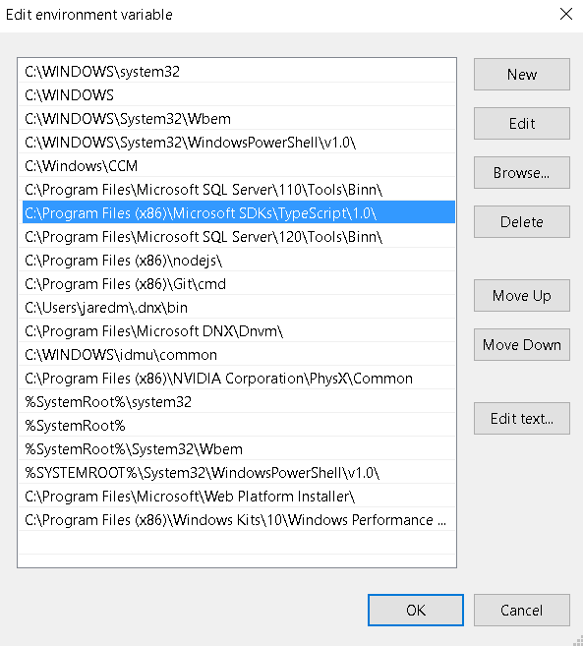
Typescript in Environment Variables

Slide 21
Different Types of Settings to Override
Default – these are the default settings that come with Visual Studio code, they are locked from you being able to change them
User – changes here impact all instances of Code on your machine. Creating a new project will inherit these preferences.
Workspace – scoped at the current project that you are working on. When committing to source code repository, these would follow the project and others could use them.

Slide 22
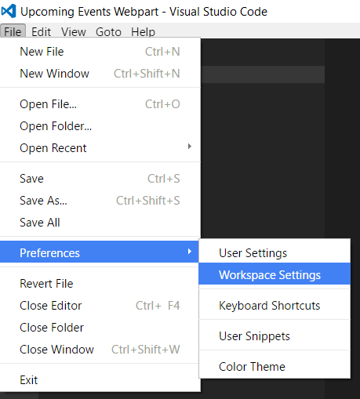
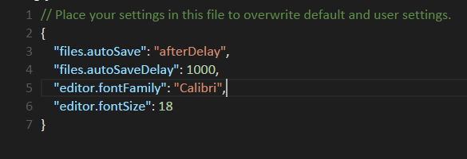
Creating unique settings

Slide 23
Building your dev environment

Slide 24
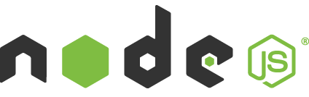
Node.js is a JavaScript runtime built on top of Chrome’s V8 JavaScript engine
Enables developers to create server-side applications in JavaScript
Node’s package system (NPM) – Node package manager will be used to pull in additional libraries as needed
Node.js has the ability to spin up web servers on your client machine

Slide 25
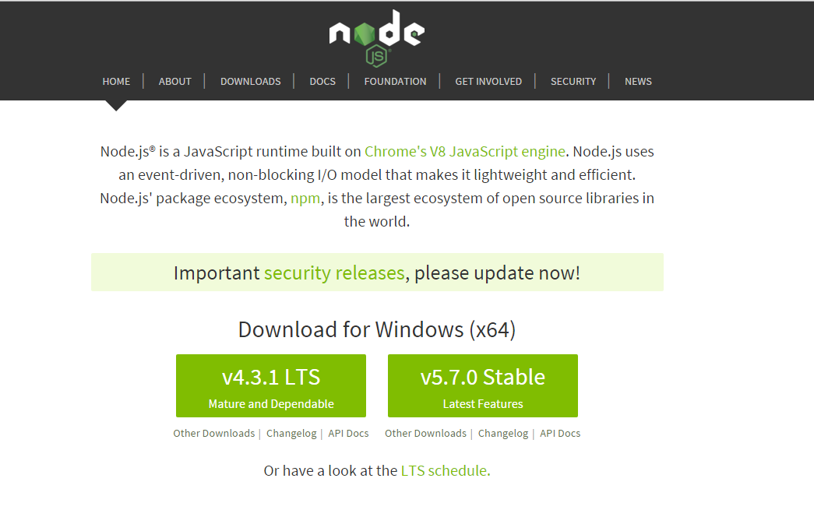
Install Node
https://nodejs.org/en/

Slide 26

NPM (Node Package Manager)
NPM comes with Node and will be how you install/manage additional modules
NPM install will become your “best friend”
Example: NPM install bower –g

Slide 27
Global vs Local Installation
If you’re installing something that you want to use in your program, using require('whatever'), then install it locally, at the root of your project.
If you’re installing something that you want to use in your shell, on the command line or something, install it globally, so that its binaries end up in your PATH environment variable.
When in doubt, install it in both ☺
https://nodejs.org/en/blog/npm/npm-1-0-global-vs-local-installation/

Slide 28
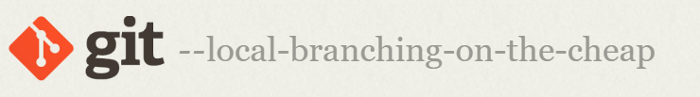

Git
Download Git
https://git-scm.com/
Check out Github

Slide 29
Bower

Slide 30

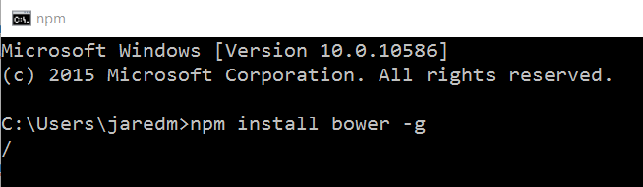
Bower
Mostly used to install client-side JavaScript libraries
Package management similar to NPM
Grabs packages from Github and then loads it into your project
Dependent on Node.JS & msysgit (for Windows)
Notes:
npm install bower –g (installs Bower Globablly on your workstation)

Slide 31
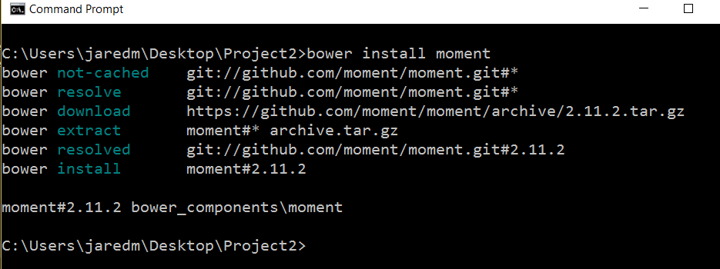
Download Moment.JS

Slide 32
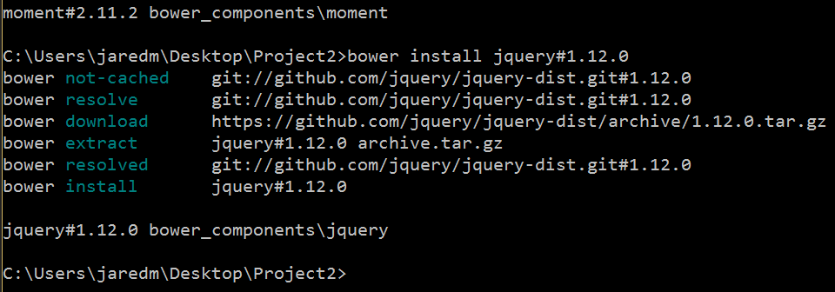
Alternatively you can install specific version

Slide 33
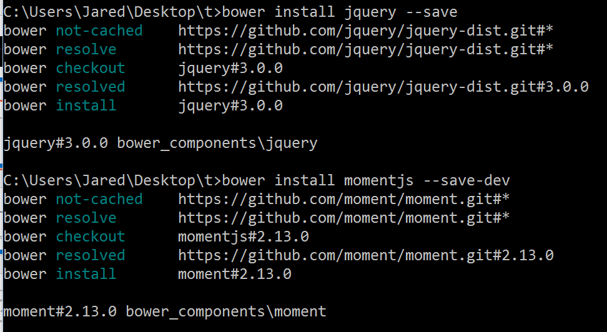
Bower install –save or –save-dev

Slide 34
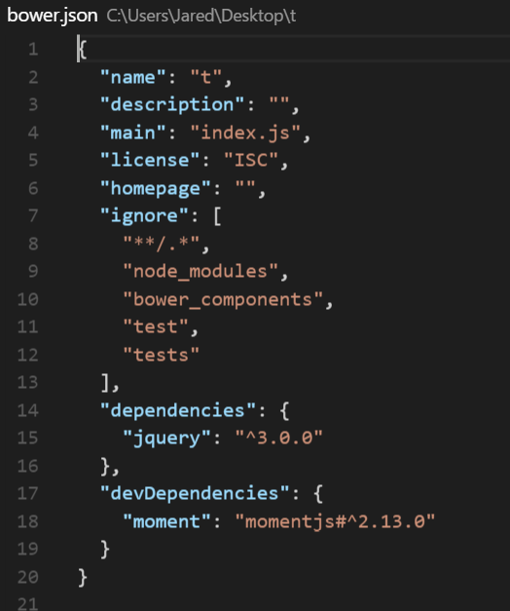
Bower.JSON
--save = Production dependencies
--save-dev = Development dependencies

Slide 35
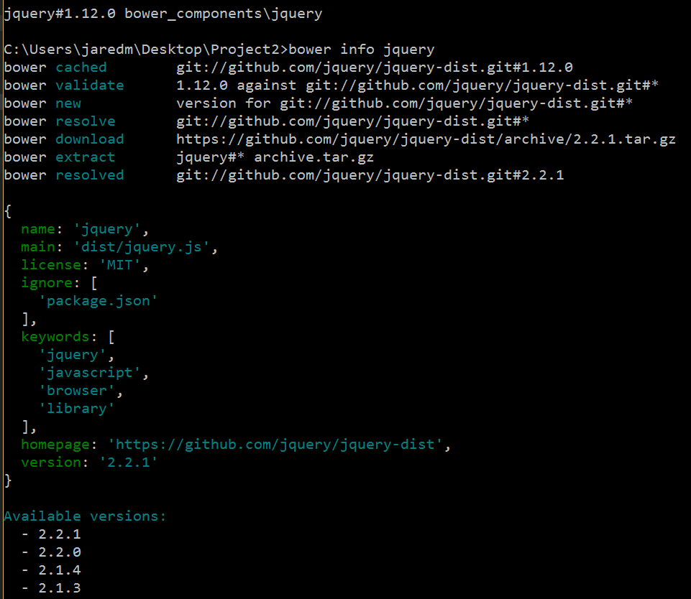
Find out package version numbers
bower info <package name>
For jQuery you will need to scroll quite
a bit since there’s a 1.x tree & 2.x tree

Slide 36
Some additional commands
Bower search <insert word here> - search for package if you aren’t sure quite what the name of it is
Bower update – this will update all of your packages to the latest available (might not be ideal for all scenarios)
Bower install <insert package here> – this will install or update a package to either the latest available or the version you specify
Bower uninstall <insert package here> – this will remove the specified package from your project

Slide 37
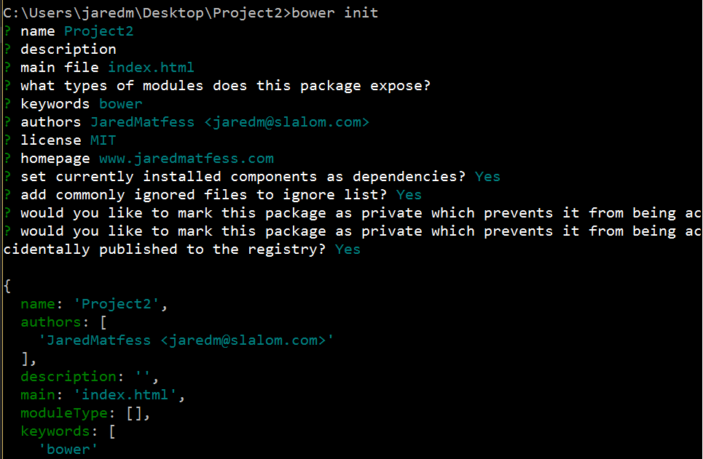
Manifest file (bower.json)
Notes:
Bring up a command prompt and type bower init in your project directory

Slide 38
Changing default location for packages
Create a file called “.bowerrc”
JSON notation, set a directory key to the folder you want packages to be installed to
Example:
{
"directory": "jslibs"
}

Slide 39
Bower Resources
Blog post - Introduction to Bower Package Manager
Bower’s Website
Pluralsight course on “Intro to Bower”

Slide 40
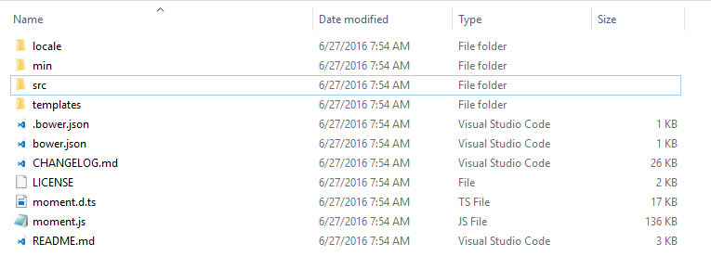
The “annoying” thing about Bower
When you do a bower install it pulls down “everything”

Slide 41
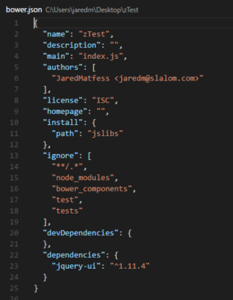
Bower-installer
NPM install Bower-installer –g
Open up your bower.json file & specify install path
  Example: “install”: { “path”: “jslibs”}
Create your bower.json file as normal with all your
usual dependencies
Run Bower-installer and it will look at dependencies &
just pull down the necessary .js files

Slide 42
Gulp / Grunt
JavaScript Task Runners

Slide 43

Grunt & Gulp

Slide 44
Automate Common Web Development Tasks
Minifying code
Concatenating files
Injecting files into HTML
Testing
Less/SASS to CSS compilation
Code Analysis

Slide 45
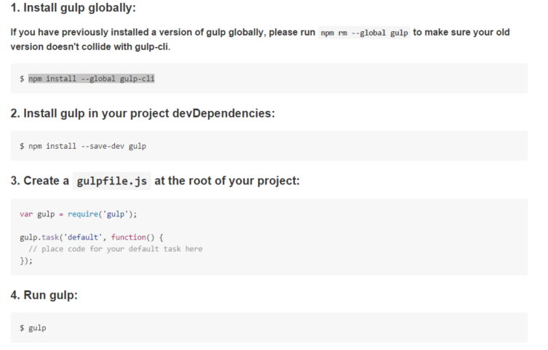
Installing Gulp

Slide 46
Gulp API’s
Gulp.task (name [,dependency], function) – define a task
Gulp.src (glob [, options]) - read files into stream
Gulp.dest (folder [,option]) – write files
Gulp.watch (glob [,options], tasks or callback function) – watch the files

Slide 47
Gulp.task
Dependency tasks run in parallel not sequence (they are also optional), and before the main function which you have defined
Most common tasks
Analyzing files – test & lint code
Optimizing files – uglify, minify, compile, etc
Serve the application – deployment

Slide 48
Gulp Plug-ins
Npm install gulp-csso --save-dev (CSS Optimization plugin)
Npm install gulp-uglify –-save-dev (Uglify – JavaScript minification)
Npm install gulp-clean --save-dev (Purges files & folders before write tasks)

Slide 49
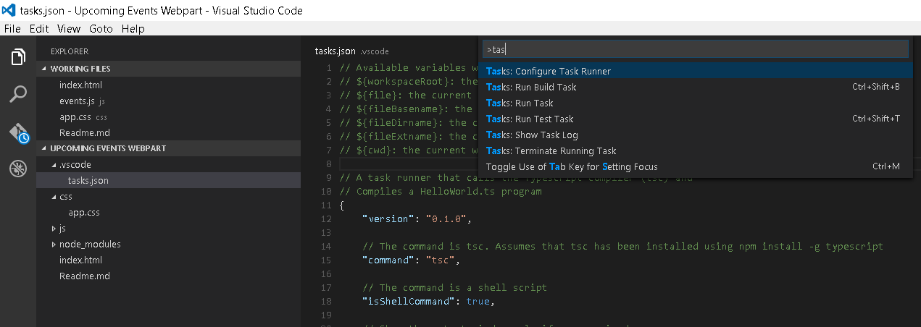
Configure the Task Runner

Slide 50
Yeoman

Slide 51
Yeoman – so what is it?
A scaffolding tool which builds out a new application
  Pulls in project dependencies
  Pulls together a build configuration
  Can leverage NPM and/or Bower for package management
Projects are referred to as “generators” which can be searched through on the yeoman site
Generators are hosted on Github which means you can NPM install them

Slide 52

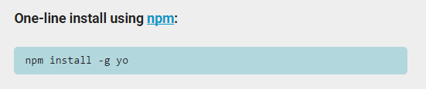
Getting setup with Yeoman
NPM install –g yo - installs Yeoman globally

Slide 53
Options for deploying files to SharePoint
Map a network drive, Gulp script to write to that drive/folder
Use OneDrive to sync local with O365
Libraries built for this task:
  Gulp-spsync
  Gulp-spsave

Slide 54
Helpful Resources

Slide 55
Helpful Resources
http://www.johnpapa.net/
Bower Fundamentals Course (Pluralsight)
Chris O’Brien’s Blog

Slide 56
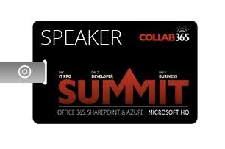
Session Recording
Collab365 Session Recording:
https://www.youtube.com/watch?v=5HEiQxmYM80

Slide 57


Let’s Connect
Jared Matfess
Solution Architect / Hartford
8604169085
jaredm@slalom.com
@JaredMatfess

