Slide 1
Modern SharePoint Development using Visual Studio Code
Jared Matfess
Slalom Consulting

Slide 2

Jared Matfess
Slalom Consulting
Jared Matfess is a SharePoint Consultant working for Slalom Consulting. He has previously worked at a large Aerospace & Defense company supporting a 60+ SharePoint environment with a 200,000 user base. He is also the founder and President of the CT SharePoint Users Group (www.ctspug.org) Jared lives in Connecticut with his amazing wife May and their cute little dog named Spoopy.
Email : JaredM@slalom.com
Twitter : @JaredMatfess
Facebook : /jared.matfess
LinkedIn : /jaredmatfess

Slide 3
Agenda
What is SharePoint Development?
Visual Studio Code
Node
Bower
Gulp / Grunt
Yeoman
Helpful Resources

Slide 4
What is SharePoint Development?
Configuration
  SharePoint Designer Workflows
  InfoPath Forms
  Content Query Webparts
  Content Search Webparts

Slide 5
What is SharePoint Development?
Code
  Visual webparts
  Server-side code (WSP’s)
  Search Display Templates
  Anything involving a programming language or scripting language

Slide 6
The Cloud’s Impact on SP Dev
Server-side code is not permitted
Microsoft continues to invest in “Cloud-first”
Microsoft Patterns & Practices are available:
  https://github.com/OfficeDev/PnP
  http://dev.office.com/code-samples

Slide 7
Code Deployment Options
Content Editor Webpart
Script Editor Webpart (terrible)
SharePoint Add-in
Provider Hosted Solution

Slide 8
The focus for this presentation
Client-side development using Visual Studio Code
  HTML
  CSS
  JavaScript
  3rd party libraries

Slide 9
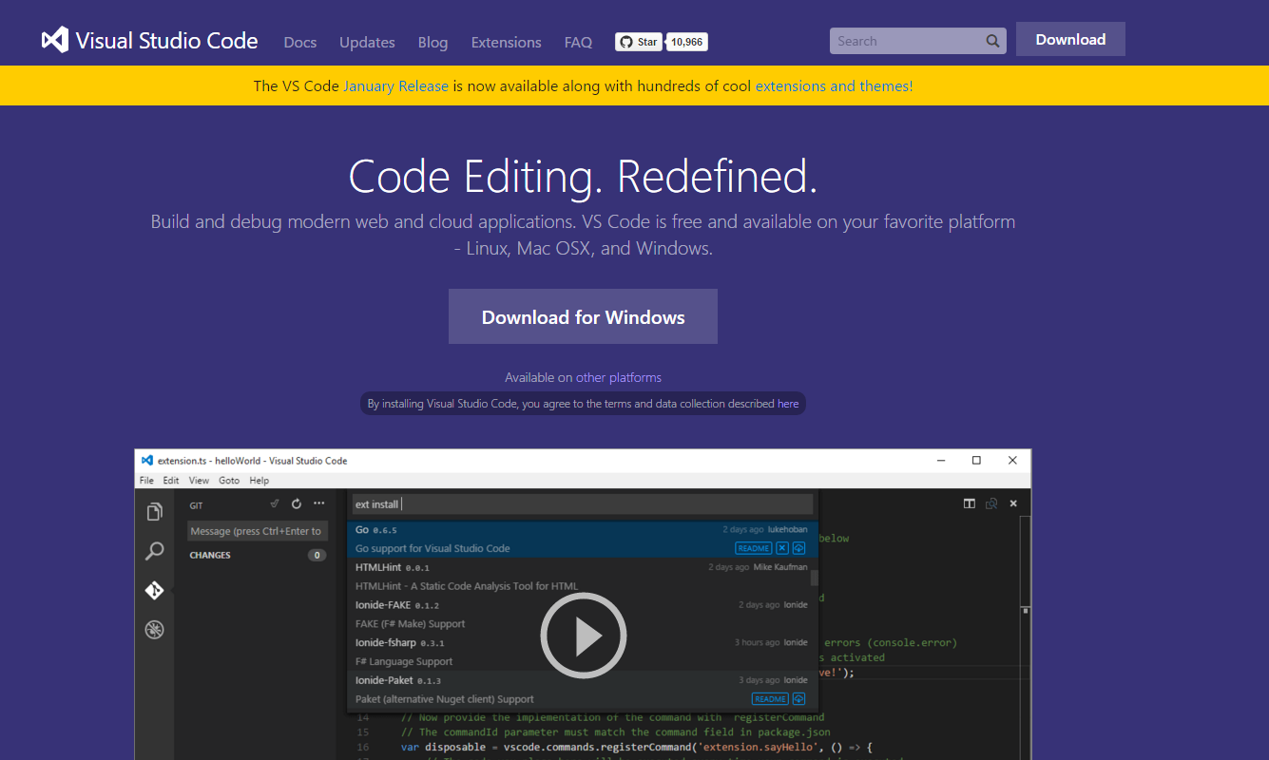
Introducing Visual Studio Code

Slide 10
Visual Studio Code
Runs on Windows, Mac, and Linux
Not a full IDE, but rather a code editor which allows for a much smaller footprint
Support Intellisense for most popular web languages (JavaScript, Typescript, etc.)
Fully customizable to meet your needs

Slide 11
Helpful Keyboard Shortcuts
Ctrl + B – toggle the explorer panel
Ctrl + 2 – for performing code reviews you can whiteboard ideas
Ctrl + 4 – zoom in
Ctrl + \ - side by side code editor (you can have up to 3 windows)
Ctrl + Shift + L – multiple cursors (after highlighting a selection)

Slide 12
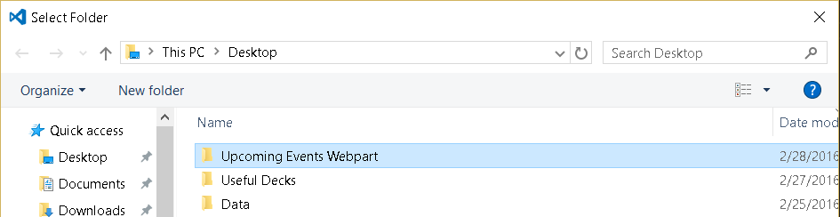
Projects
Visual Studio Code’s concept of Projects are defined at the folder level

Slide 13

Quick HTML build-out using Emmet
Create new file and save as .HTML
!>div>ul>li*5 – hit tab and watch it build out your code
http://docs.emmet.io/
Notes:
!>div>ul.nav>li.navItem*5

Slide 14
Code settings to override
Default – these are the default settings that come with Visual Studio code, they are locked from you being able to change them
User – changes here impact all instances of Code on your machine. Creating a new project will inherit these preferences.
Workspace – scoped at the current project that you are working on. When committing to source code repository, these would follow the project and others could use them.

Slide 15
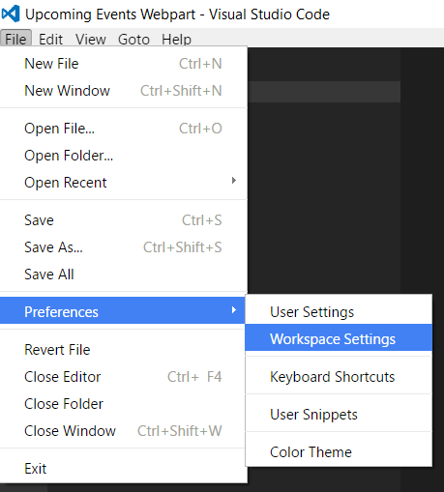
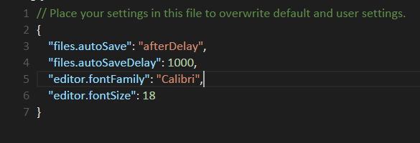
Code settings to override

Slide 16
Building Our Your Dev Environment
Traditional SharePoint Development using Visual Studio included a “Build” step
This doesn’t exist in Client-side solutions therefore you need to “roll your own”

Slide 17


Slide 18
Node.js is a JavaScript runtime built on top of Chrome’s V8 JavaScript engine
Enables developers to create server-side applications in JavaScript
Node’s package system (NPM) – Node package manager will be used to pull in additional libraries as needed
Node.js has the ability to spin up web servers on your client machine

Slide 19
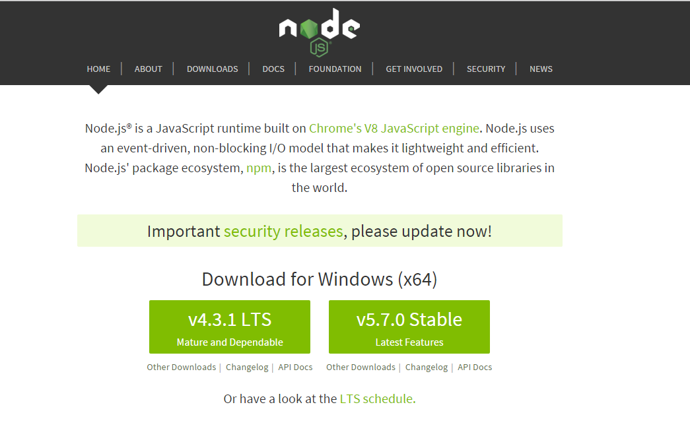
https://nodejs.org/en/

Slide 20


Slide 21
Package manager for client side libraries
Does the same thing as NPM
Grabs packages from Github and loads into your project
Dependent on Node.JS

Slide 22
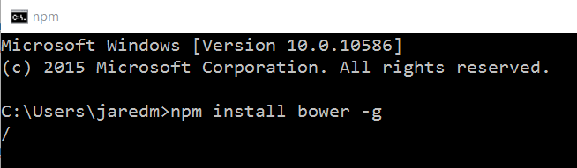
Installing Bower

Slide 23
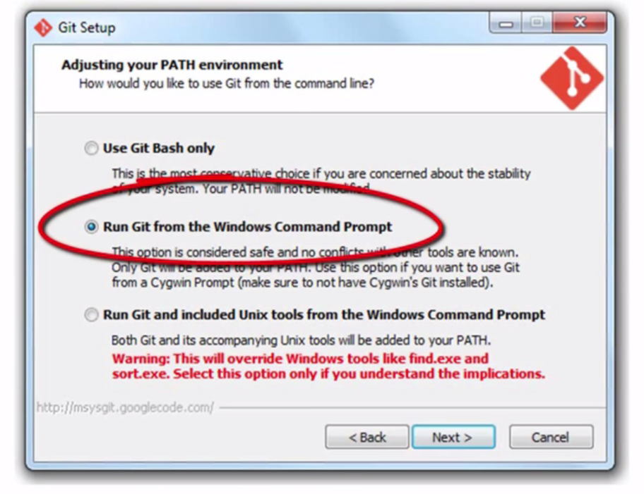
Run Git from Windows Cmd Prompt

Slide 24
Some additional commands
Bower search <insert word here> - search for package if you aren’t sure quite what the name of it is
Bower update – this will update all of your packages to the latest available (might not be ideal for all scenarios)
Bower install <insert package here> – this will install or update a package to either the latest available or the version you specify
Bower uninstall <insert package here> – this will remove the specified package from your project

Slide 25
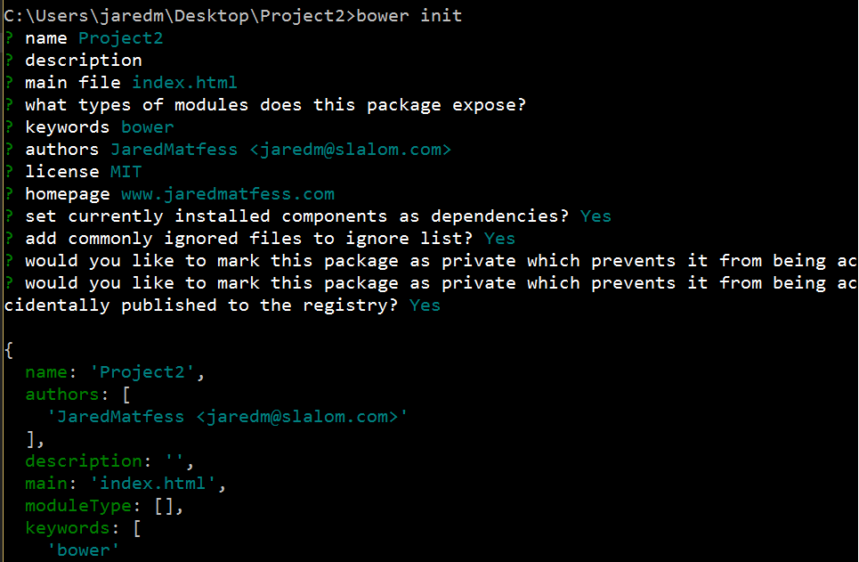
Manifest file (bower.json)

Slide 26
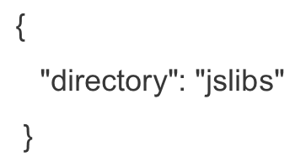
Changing package location
Create a file called .bowerrc
JSON notation, set a directory key to folder:

Slide 27

Grunt & Gulp
Notes:
JavaScript task runners – both are very popular
Grunt is more configuration
Gulp is more code-based

Slide 28
Automate Common Dev Tasks
Minifying code
Concatenating files
Injecting files into HTML
Testing
Less/SASS to CSS compilation
Code Analysis

Slide 29

Gulp
Code-based JavaScript task runner
Stream-based – files are read/written
https://github.com/gulpjs

Slide 30
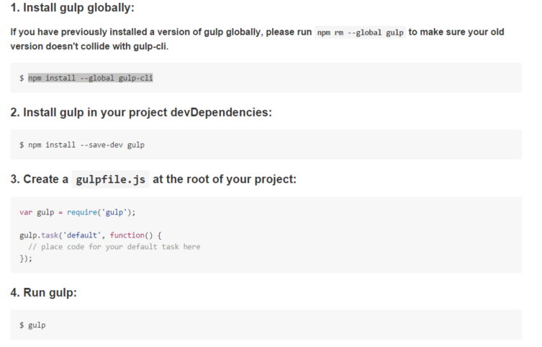
Installing Gulp

Slide 31
Gulp API’s
Gulp.task (name [,dependency], function) – define a task
Gulp.src (glob [, options]) - read files into stream
Gulp.dest (folder [,option]) – write files
Gulp.watch (glob [,options], tasks or callback function) – watch the files

Slide 32
Gulp.task
Dependency tasks run in parallel not sequence (they are also optional), and before the main function which you have defined
Most common tasks
Analyzing files – test & lint code
Optimizing files – uglify, minify, compile, etc
Serve the application – deployment

Slide 33
Gulp Plug-ins
Npm install gulp-csso --save-dev (CSS Optimization plugin)
Npm install gulp-uglify –-save-dev (Uglify – JavaScript minification)
Npm install gulp-clean --save-dev (Purges files & folders before write tasks)

Slide 34


Slide 35
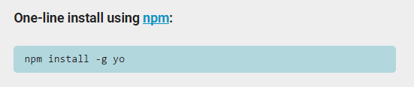
Yeoman
Scaffolding tool which pulls down all the necessary libraries, files, etc. to build out your web application project

Slide 36
DEMO

Slide 37
Helpful Resources
http://www.johnpapa.net/
Bower Fundamentals Course (Pluralsight)
http://www.n8homepaged.at/blog/how-i-develop-in-sharepoint-and-office-365-now/
Gulp-Sync (Wictor Wilen)

Slide 38
Grab my code samples
Open up a command prompt
Navigate to a location that you would like to use for development
Create a new directory
Type in git clone https://github.com/jaredmatfess/modernspdev.git
Wait and it will download all the files to your local machine

