Slide 1
Yes we can!
Enabling Collaboration in a Locked Down SharePoint Environment!
Jared Matfess
Consultant, Slalom Consulting
#BASPUG

Slide 2


The Problem with SharePoint
Framing your security “opportunity”
Building blocks for your solution
Getting your A.C.T. together

Slide 3

About Me
SharePoint Consultant with Slalom Consulting
10+ years in the IT Field, 0 book deals
President of CT SharePoint Users Group (www.ctspug.org)
Blog: www.jaredmatfess.com
Twitter: @JaredMatfess
E-mail: JaredM@slalom.com

Slide 4

The inspiration for the CTSPUG

Slide 5
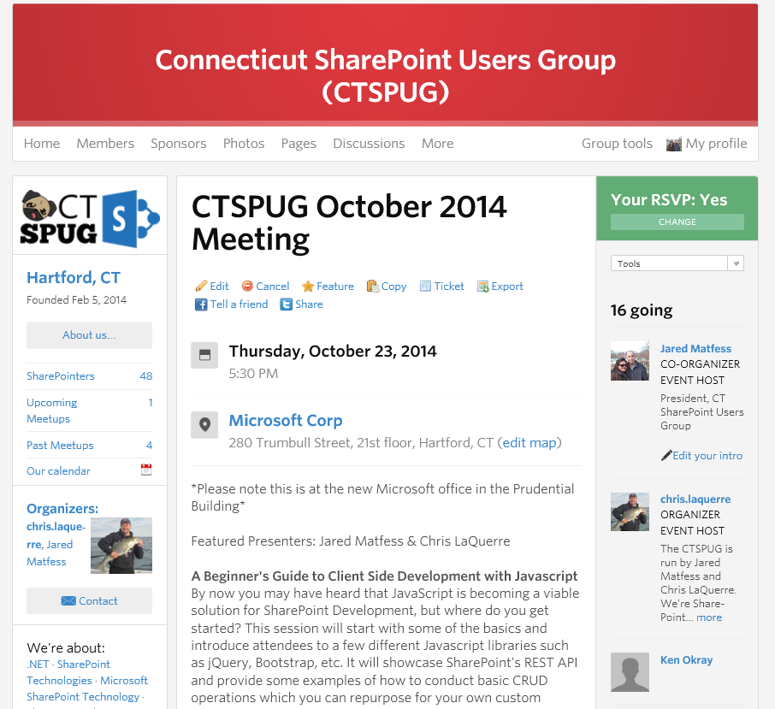
About the CTSPUG
Meets 3rd Thursday of the month
Microsoft Office in Hartford, CT
http://www.meetup.com/ctspug

Slide 6

SharePoint Saturday CT is coming!
www.spsevents.org/ct/ct2014

Slide 7
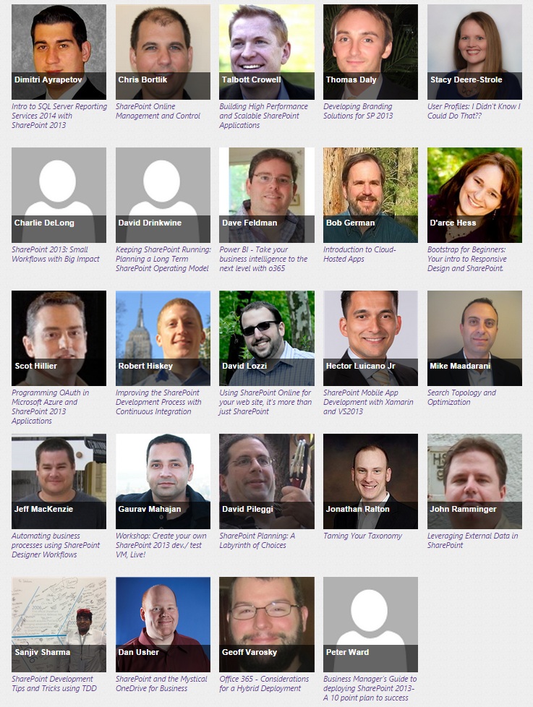
Lots of awesome speakers!

Slide 8
My Background
Worked 11 years at United Technologies Corporation
Started in Communications as a co-op
SharePoint, Infrastructure, Networking, Project Management, eBusiness
Designed their US/FN collaboration solution for non-technical data collaboration
Notes:
We had a 200,000 person implementation – around 50% of our company is overseas
60+ servers
Large implementation
This stuff isn’t easy

Slide 9
Presentation Background
SharePoint has the potential to drastically disrupt the normal operations for large corporations
Navigating the political/social stigma of a collaborative technology in a regulated industry can be fun
Here are some best practices, lessons learned, and tips for your own implementation
Notes:
We had a 200,000 person implementation – around 50% of our company is overseas
60+ servers
Large implementation
This stuff isn’t easy

Slide 10
The Problem with SharePoint
“The days when it isn’t awesome”

Slide 11


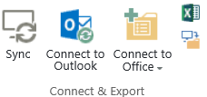
SharePoint
SharePoint makes it almost too easy to share files
  Upload, Sync, Drag & Drop, Open in Explorer
  Multiple devices supported
It also includes Share in the name! ☺

Slide 12
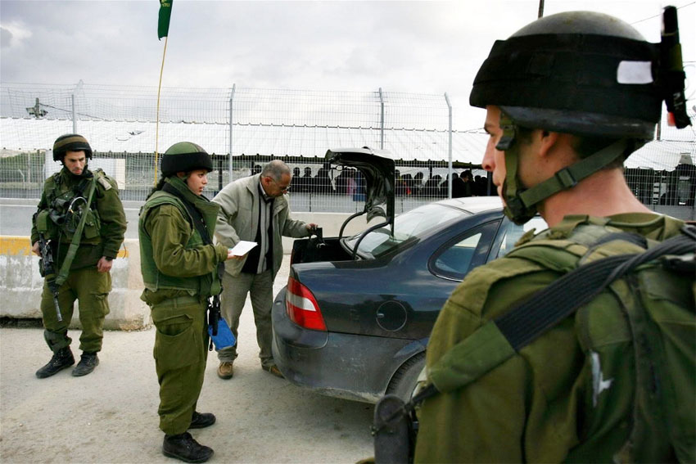
What your CSO wants for SharePoint

Slide 13

What your users want

Slide 14
Why do mistakes happen?
People – someone shares a file with someone who shouldn’t see it
Process – the process for sharing data failed
Technology – there weren’t adequate controls in place to enable to required collaboration while including mistake proofing steps

Slide 15
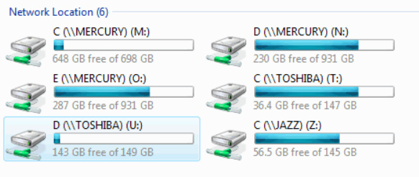
Where am I?
File shares are very ambiguous and lead to mistakes
Users might understand the title but not the purpose for the share
How would a user know the difference between the N & O Drives?

Slide 16
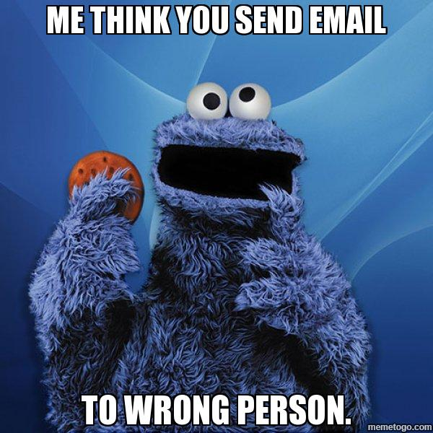
Whoops! Sent to the wrong person!

Slide 17

How SharePoint “Helps”
Some organizations roll out SharePoint without careful planning, and then you get into a situation where the looney’s are running the insane asylum
Notes:
For those that first venture into SharePoint, it’s often times viewed as a file share that the business has the ability to manage the file permissions for.. Creating subsites, granting others Full Control, it can get out of hand right quick.

Slide 18
Framing your opportunity
Figuring out what you need to solve

Slide 19
What are your data concerns?
Intellectual property?
Company private/sensitive such as salary planning?
Mergers and acquisitions data which could impact stock price?
Are the concerns regulatory? HIPPA, Export Control, PII?
Are there retention policies surrounding your data?
Notes:
SharePoint 2010+ is not certified with DoD 5015.2
Microsoft recommends adding one of their partners to your SharePoint solution
It can be secured – it is HIPPA compliant

Slide 20

You need to engage your business!
Information Technology Security
Compliance
Legal
Human Resources
Notes:
You can’t do a major data protection project without engaging your business. They know their data!

Slide 21

Your goal – guide your users to success
Notes:
You want to guide your users to the intended goal – you want them to be able to collaborate with their colleagues. Enabling innovation is what will continue to drive your company to success.

Slide 22

Define your data security requirements
Identify logging/auditing requirements
Target the data which needs to be secured
  Leverage existing DRM technology
  Force data classification on data upload
User / data separation requirements

Slide 23
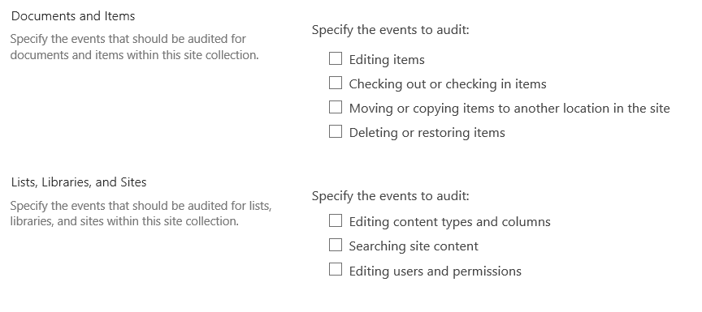
What do you want to audit?

Slide 24
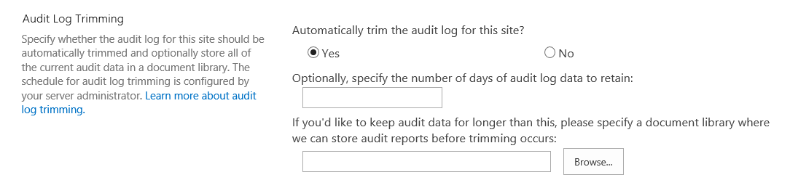
How long do you want to keep the data?
Recommend enabling audit trimming
Consider 3rd party solution for long-term archiving / reporting on audit data
Notes:
OOB Audit retention is 30 days

Slide 25
Quick demo
Site Collection Auditing

Slide 26
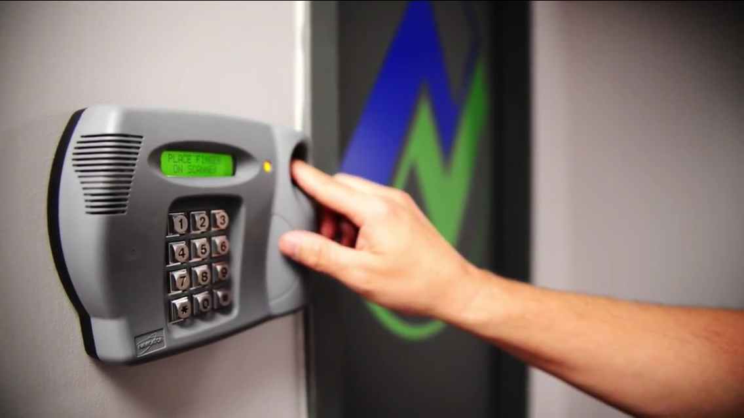
How will you secure that data?

Slide 27
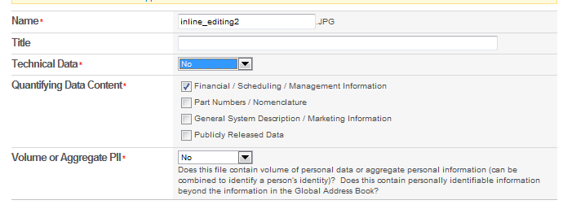
Document classification
There’s no good way to turn classification on for all documents
Don’t modify the out of the box Document Content Type!
Consider leveraging unique Content Types
Question for those playing at home:
How do you force document classification
for all documents being uploaded into SharePoint?

Slide 28
Reporting
Try to map your user requirements to relevant reports
Help drive the audit discussion so you can help shape the report outputs
Consider a 3rd party vendor: AvePoint, HarePoint, Metalogix, WebTrends based on requirements

Slide 29
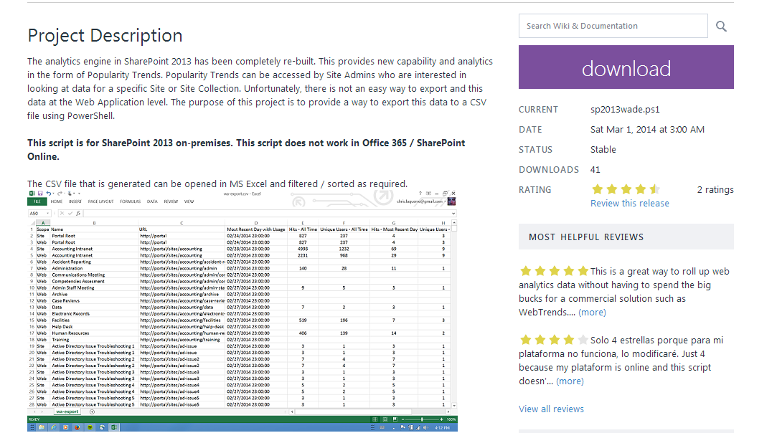



Web Analytics to CSV CodePlex Project!
Chris LaQuerre
https://sp2013wade.codeplex.com/

Slide 30
Building blocks for your solution
Tips & tricks from the field

Slide 31
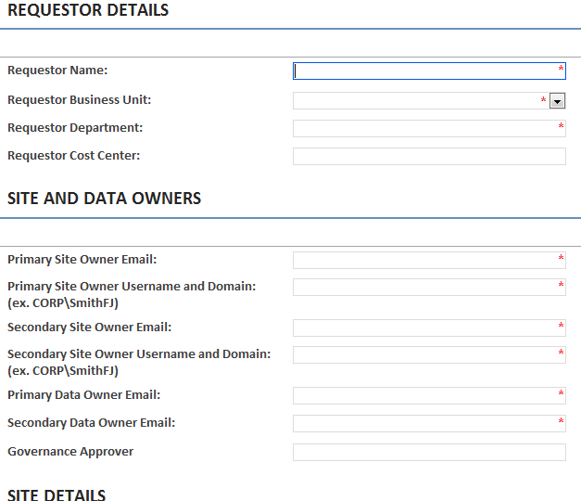
Start at your site request process
Identify your decision making questions
Capture key field as metadata
  Store in site collection property bag
  Also consider hidden list in site collection
Meet with your customers to understand
what they are requesting
Notes:
*Hidden lists are good because they can

Slide 32
Powershell to create custom property
Powershell to add a custom entry CTSPUG President to the property bag
$site = New-Object Microsoft.SharePoint.SPSite("http://www.ctspug.org")
$rootWeb = $site.RootWeb
$rootweb.AllowUnsafeUpdates = $true
$rootweb.Properties.Add("CTSPUG President", "Jared Matfess")
$rootweb.Update()
$rootweb.Dispose()
Consider including this to your Site Collection creation process

Slide 33
Bonus! SharePoint 2013
SharePoint 2013 supports creating an indexed property in an SPWeb Property bag!
Example:
$web = Get-SPWeb http://sharepoint.ctspug.org
$web.AllProperties[“ExportControl"] = “ITAR"
$web.IndexedPropertyKeys.Add(“ExportControl")
$web.Update()
$web.Dispose()

Slide 34
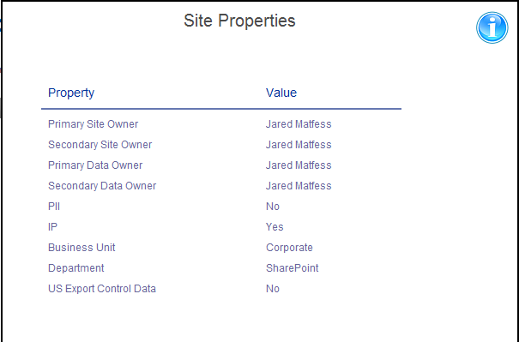

Expose Site Metadata to Users
Display data captured during site collection process
Ensure you have process for keeping data current
Great post!
Jeremy Thake
http://goo.gl/emfLVi
Notes:
Jeremy Thake put out a great post on how to read property bag using CSOM

Slide 35
Data Separation by Web Application
SharePoint Farm
US Person Web Application
Foreign Person Web Application
Executive Only Web Application
Notes:
When building your SharePoint environment you can consider creating logical separation within the SharePoint environment. Establishing key boundaries for what type of collaboration is allowed in a particular area.

Slide 36
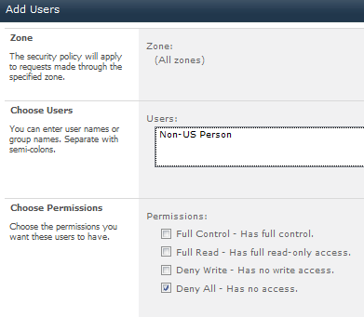
Technical Implementation
Created web applications and set user policies that would “Deny All” to users that did not meet the container requirements.
Relies on global Active Directory Groups such as “All Domain Users”

Slide 37
What about claims?
What is a claim?
  It’s a piece of information describing the user such as:
    E-mail
    Work location
    Active Directory Group Membership
Examples:
Windows Account: i:0#.w|slalom\jaredmatfess
FBA Account: i:0#.f|fbamembership|jmatfess
SAML Account: i:05.t|slalom-saml|jaredm@slalom.com

Slide 38
Dynamic groups leveraging claims
Consider having a developer create a custom claims provider
Claims at a high level are conditions you can establish about a user
Example: Marketing user claim can be established if Department = “Marketing”
Use these claims to prevent “Non-Executives” from accessing a web application
Great TechNet Article (written by Scot & Ted Pattinson)
http://msdn.microsoft.com/en-us/library/gg615945.aspx

Slide 39

Claims “Gotcha’s”
When setting any sort of “Deny All” consider your administrators and any service accounts that make SharePoint run!!
How clean is your Active Directory environment?
  Make sure your developers consider columns that might be NULL
  Perform some analysis on Active Directory data before building anything!
  What processes exist to keep user data accurate?

Slide 40
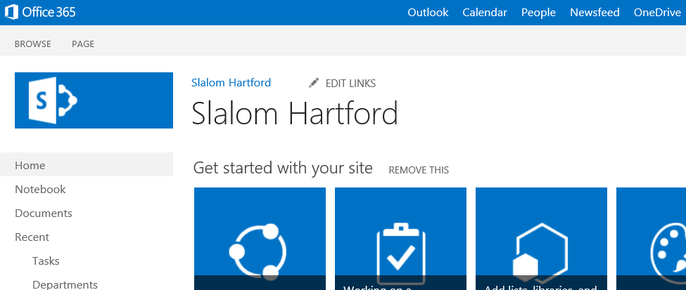
Mistake-proofing steps
Include visual cues to help inform users what is acceptable data
PII data is not allowed in this site

Slide 41
SharePoint Permissions
#1 Governance decision is who gets what access in SharePoint
Consider custom permissions / roles but be consistent
Example:
Role | Overview
Site Power User | Business Power User who owns the site
IT Power User | Non-SharePoint Team
Contributor (No Delete) | Business user
Web Analytics Viewer | Manager role who needs metrics

Slide 42

Who’s managing permissions?
Business Users are managing permissions
  Users can give other people “Full Control”
  Governance can get thrown out the window
IT is managing permissions
  Slows down adoption
  Someone has to “do the work”
  Hurts ad-hoc collaboration

Slide 43

Demo: Permissions…
Do I have permission to show you permissions?

Slide 44
Dirty Compromises
Try to only use Active Directory groups for permissions
  Rely on existing processes for populating those groups
Give business users “Manage Permissions” but rely on 3rd party tools or custom scripts to report on user access
  Hire a team to manage/oversee this ☺

Slide 45
Pro Tip: Group Owners can add users!
You can make your business users the owners for groups and allow them to add/remove individuals without manage permissions access!

Slide 46
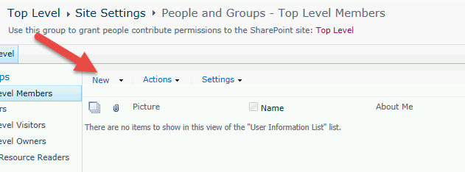
ProTip: (continued)
Navigate to the group from the site permissions screen and then add/remove the user from that screen

Slide 47

Quick Demo:
Group Owner’s acting like a boss..

Slide 48

Back to building your solution…

Slide 49

Manual vs Build vs Buy
Manual: Keep your processes & access tightly controlled
Build a custom solution:
  Event receivers on document upload
  Timer jobs to confirm configuration
  PowerShell scripts for reporting / Web Analytics
Buy: Partner with a 3rd party such as AvePoint / Metalogix / Hi Software

Slide 50
Prototype & scale it out
Great ideas can start with a SharePoint Designer Workflow
(but shouldn’t necessarily end with it in a large scale environment)
Work with users to prove out ideas and improve
Consider the implications when everyone is in the system

Slide 51
Getting your A.C.T together
Planning for future success

Slide 52
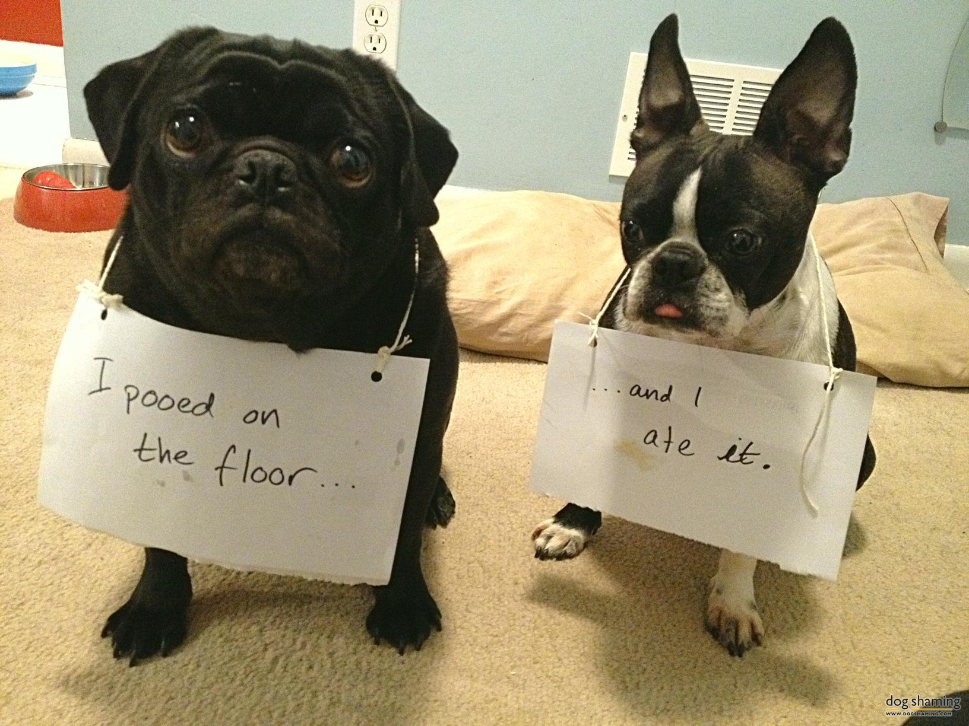
Warning! Dog food slides!!

Slide 53
A.C.T. – A Security Framework
Collaborative sharing of goals, objectives, and challenges across departments
High level of information sharing across the organization
Alignment with industry best practices and market trends
Changing a culture of “No”
to a culture of informed “Yes”
Leadership support for cross-functional innovative solutions
IT as an enabler, not as obstacle, towards business growth
AWARENESS
To comprehend events
in context and
anticipate future events.
CULTURE
To empower collaborative decision-making to
solve problems in
a secure manner.
TECHNOLOGY
To utilize effective technology tools in support of
a secure solution.
Technology not as an “end all, be all” solution
Technology as a tool to aid and support
a culturally aware organization
Notes:
Success means multi-faceted approach to dealing with security
Awareness – organizational alignment with industry best practices and making security a “Roadmap” item
Culture – Security doesn’t mean no it means yes but with caveats – IT enabling, not forcing users to go to Cloud or Shadow IT
Technology – it won’t cure cancer, so it’s a partnership of technology to aid the culture & awareness

Slide 54
Enacting the ACT methodology
Identify projects
Evaluate progress
Determine project profile
Start
A realistic diagnostic must be established in order
to assess where portfolios and projects currently stand in respect to Awareness, Culture, and Technology.
1
Implement & monitor
Assess project risk
Build
The organization should accurately gauge their current state and develop realistic objectives in building towards maturity, as well as prioritizing future initiatives.
2
Determine action plan
Define current state
Improve
ACT is iterative in nature and can be applied to multiple programs and projects across
an organization to drive towards maturity.
Set objectives
3
Notes:
How do you begin?

Slide 55
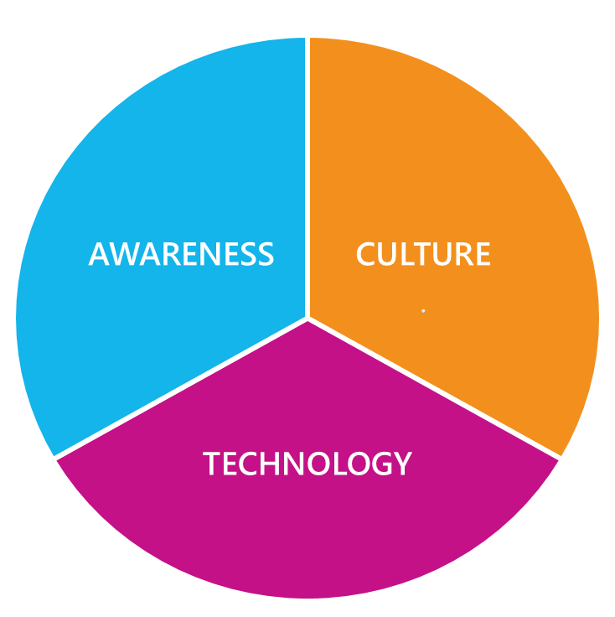
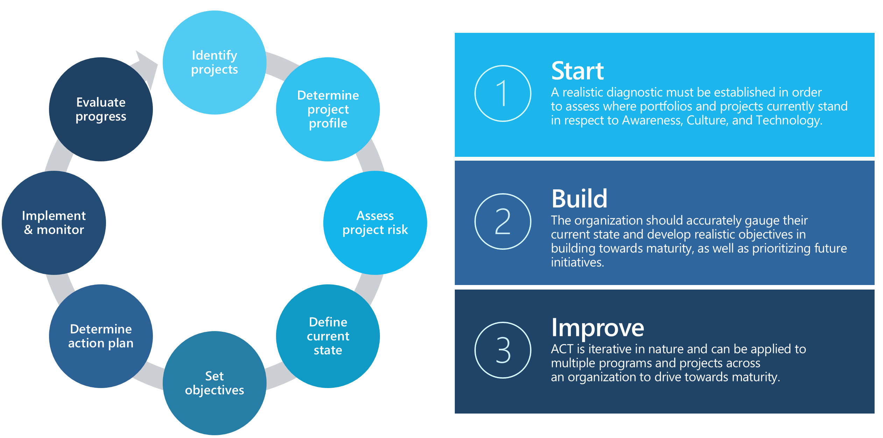
ACT in Action
Common Areas
Organizational Effectiveness
Risk Management
Operational Enhancement
Education, Training and empowerment of employees
Methods to increase collaboration
Usage of Tools to increase awareness, collaboration and incentives
Assess and improve existing Risk Management processes
Design and implement new Risk criteria and impacts
Iterative risk management processes through the use of technology and templates
Assess and improve existing operational security policies, procedures and technologies
Design and implement iterative processes backed by strong policies and procedures
Increased automation and technology tools

Slide 56
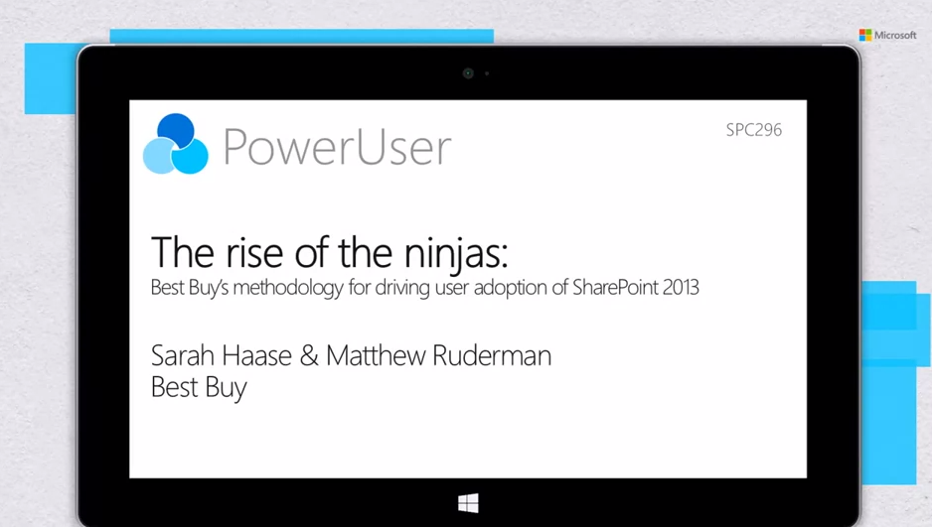
Recommended adoption session!
http://channel9.msdn.com/Events/SharePoint-Conference/2014/SPC296

Slide 57
Summary

Slide 58
In closing..
SharePoint Security is difficult but there are options
Prototype with simple solutions but always test for scale
Communication & training plans are the keys to success
Don’t be afraid of process improvement
They did name it SharePoint for a reason
Consider a security methodology like A.C.T

Slide 59
References
Paolo Pialorsi – Authentication & Authorization Infrastructure in SP2013
http://channel9.msdn.com/Events/SharePoint-Conference/2014/SPC401
Slalom’s ACT Methodology by Daniel Chiang
https://www.slalom.com/thinking/ACT-a-new-perspective

