Slide 1
Beginning SharePoint Development with JavaScript, AJAX, Bootstrap, and more..
Jared Matfess & Chris LaQuerre

Slide 2















Was made possible by the generous support of the following sponsors…
And by your participation… Thank you!

Slide 3



Be sure to fill out your eval form & turn in at the end of the day for a ticket to the BIG raffle!
Join us for the raffle & SharePint following the last session

Slide 4
What we’ll cover today
JavaScript in Content Editor Web Part (CEWP)
JavaScript in an ASPX page – created in SharePoint Designer (SPD)
REST – CRUD operations
Bootstrap – just the basics
Client Side Rendering – just a cursory glance
Session Goals
Provide enough information for you to get started with a few basic examples to get past the initial learning curve
Focus on approaches that can be utilized by a Site Owner in SharePoint 2010 / 2013 on premise or Office 365 without the App model

Slide 5

Session warning
This session is awesome
There will be some code
There will be awesome demos

Slide 6

About Jared
SharePoint Consultant with Slalom Consulting
10+ years in the IT Field, 0 book deals
President of CT SharePoint Users Group (www.ctspug.org)
Blog: www.jaredmatfess.com
Twitter: @JaredMatfess
E-mail: JaredM@slalom.com

Slide 7

About Chris
SharePoint Lead at Saint Francis Hospital
15+ years IT experience
Got married in April
Not president of CT SharePoint Users Group (www.ctspug.org)
Author of SharePoint 2013 Web Analytics Data Export CodePlex project
  http://sp2013wade.codeplex.com

Slide 8


About Schmidt
Great movie starring Jack Nicholson
Has nothing to do with our presentation
Spoiler Alert: Kathy Bates skinny dips in a hot tub

Slide 9
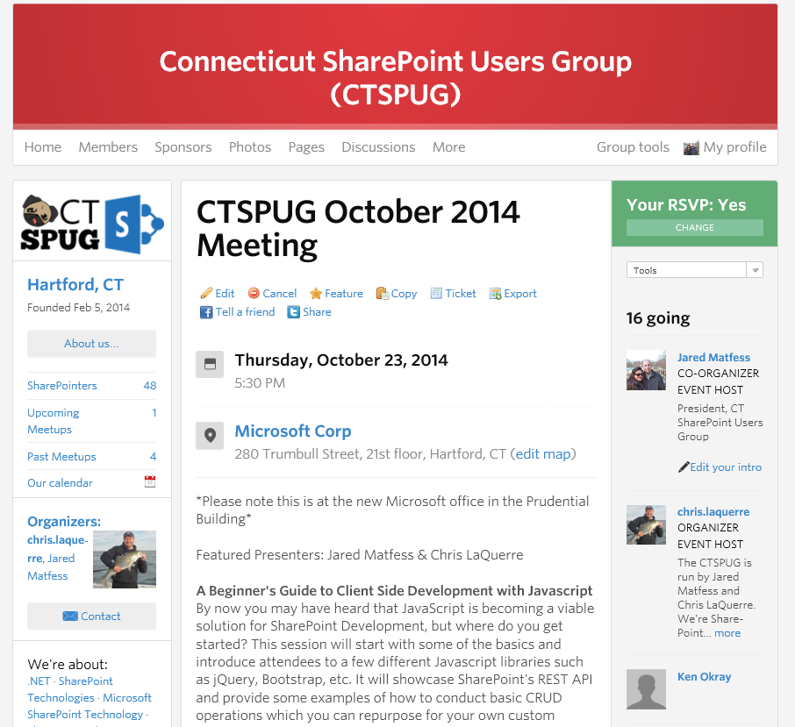
About the CTSPUG
Meets 3rd Thursday of the month
Microsoft Office in Hartford, CT
http://www.meetup.com/ctspug

Slide 10

SharePoint Saturday CT is coming!
www.spsevents.org/ct/ct2014

Slide 11
Demo
$("#code").show();
“Here’s where it gets awesome..” –This Guy

Slide 12

So why Client Side Development?
Why JavaScript?

Slide 13

SharePoint “upgrades” are terrible
Notes:
Conversation about upgrading SharePoint is a real pain..And you might be
Microsoft MVP, Works for Rackspace
SharePoint Admin Netcast
Quick Todd Klindt shout-out – Mondays @ 8:30 PM CST – http://www.toddklindt.com

Slide 14
The pain..
Migrating lots of old data
The fight to define (or justify) Information Architecture
The G-Word (Governance)
Technology – acquiring the hardware
Addressing the Customizations
Notes:
All that server side code..
Branding
Missing source code
Elevation of privs to the farm account - can do whatever it wants
Consumes less resources on the server (javascript)
Brings down the environment – 55 WSP’s @ old company

Slide 15

Does it need to be server side code?
Server Side Code
  Timer jobs
  Custom site definitions
  3rd party products where you have no choice
  Custom workflows (when you don’t own Nintex or K2)
Client Side Code
  Everything else
Notes:
*** Back in the day the thinking was server side first, and client side “maybe” ***
** Today’s thinking – Client Side first **
If the answer is No – go client side..
Default client side – vs old model of defaulting server side

Slide 16
JavaScript Basics
So easy, even these two bozos can follow along…

Slide 17
The timeline of JavaScript
The Big Bang
The Dawn of Man
JavaScript

Slide 18
An important discovery
The First Important Discovery of the 21st Century
JavaScript has good parts

Slide 19
A Slightly Less Brief History
1995 LiveScript written in 10 days
1997 Browser wars escalate
1999 JavaScript ES3 (do-while, RegEx, exception handling)
2005 Ajax coined
2006 Rise of libraries (jQuery, YUI, Dojo, MooTools)
2009 JavaScript ES5 (Strict mode, getters / setters / JSON)
2010 Browsers are somewhat standard
2011 Rise of the frameworks (Angular, Ember)
2012 Server-side JavaScript gains popularity

Slide 20
The Nature of JavaScript
Its dynamic
  Objects can be directly created without first creating an object factory (e.g. a class)
  Properties can be freely added and removed from objects after creation
It fails silently
  Exception handling wasn’t added until ECMAScript 3 which is why the language often fails silently and automatically converts the values of arguments and operands
It’s deployed as source code
  Anyone can view the source
  Compression and magnification are frequently used for performance and obfuscation
It’s part of the web platform
  JavaScript is an essential part of the web (HTML5 APIs, DOM, etc.)
  JavaScript is increasingly being used in non-browser settings (ex: Node.js)

Slide 21

Elegant Parts
Functions as First Class Objects
  The best thing about JavaScript
  Can and should be passed around
Dynamic Objects with Prototypal Inheritance
  Objects are class-free
  Objects can be easily created and modified
Object Literals and Array Literals
  Convenient notation for creating new objects and arrays
  Inspiration for JSON data format

Slide 22

Quirks and Missing Features
Global variables
No Block Scoped variables
No Built in Modules
No support for Subclassing
Floating point arithmetic
No “real arrays”
Automatic semi colon insertion

Slide 23
Too Long Didn’t Read (TLDR)
JavaScript is a very flexible language with a reasonably elegant core which enables a mixture of object oriented programming and functional programming

Slide 24
Some tips on Variables
Always declare your variables!
If you do not declare you variables they will be placed in the global scope which could lead to possible collisions
  Incorrect: attendees = “awesome”;
  Much Better: var attendees = “awesome”;

Slide 25
JavaScript Basics
JavaScript is dynamically typed
  Variables and object properties can always hold values of any type
Strings – textual content can be wrapped in single or double quotes
var jared= “Best presenter ever”; //Totally valid
  var jared= ‘Much better presenter than Chris’; // Also valid

Slide 26
AJAX / $.ajax
This transformed JavaScript from being a light scripting language to a data driven application platform
Asynchronous Javascript & XML
  With or without XML ☺
Sends and receives data in a variety of formats – JSON, XML, HTML, and Text
Allows you to send/receive without the need to refresh the page
  Makes web applications feel like desktop applications

Slide 27
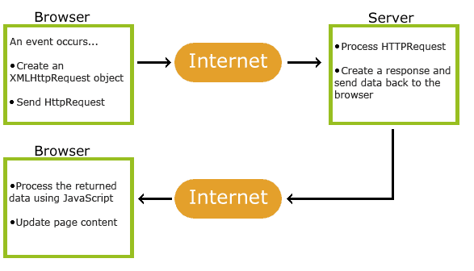
How AJAX works

Slide 28
There’s a library/framework for that…
Figuring out where to go with all those libraries & frameworks
Notes:
Still Jared **

Slide 29
Benefits of JavaScript
SharePoint Admins are happy to get those WSP’s out of their farm
Developers are happy because they can deploy new functionality without those grumpy SharePoint Admins
JavaScript skills translate to other opportunities outside of SharePoint

Slide 30








It’s starting to feel a lot like NASCAR
Notes:
***Thousands of JavaScript libraries / frameworks are available to facilitate development of JavaScript-based applications
*** Wikipedia’s list of “notable” JavaScript libraries contains 65 items

Slide 31
Our recommendation for beginners…
Here are the frameworks / libraries that I’d like to talk about:
JavaScript
jQuery
  Most of the code samples you'll find on the web use jQuery
Bootstrap
*As advertised in the session description ☺

Slide 32
jQuery
jQuery is the most popular JavaScript library in use today
  Used by over 60% of the 10,000 most visited websites
  It’s probably in your environment and you don’t even know it
Greatly simplifies cross-browser client-side scripting of HTML
  Handles compatibility issues with older browsers (ex: IE6 / IE7 / IE8)
Most SharePoint code examples on the internet use jQuery
Notes:
Chris starts speaking

Slide 33
Where do I put my scripts?
Option #1 | Place code directly in Content Editor Web Part (CEWP) Not so good
Option #2 | Create a “Scripts” library and put them there – much better Enable Versioning (just in case)
Option #3 | Drop it in the hive (on premise only)? Only if you want to dance with danger
Option #4 | Bundle with a SharePoint App (2013 only)

Slide 34
What tools do I need to write code?
Your favorite text editor (ex: NotePad ++)
Visual Studio
Sublime
Web Storm
Emacs or Vim for the hardcore
The list goes on and on…
Notes:
Chris speaks to this slide

Slide 35
What tools do I need to troubleshoot code?
Internet Explorer F12 Developer Tools
Chrome Developer Tools
Firefox / Firebug
Fiddler
Notes:
Chris speaks to this slide

Slide 36
REpresentational State Transfer (REST)
Figuring out where to go with all those libraries & frameworks
Notes:
** Chris is REST-less **

Slide 37
REpresentational State Transfer (REST)
Something Roy Fielding described in 2000 as a way to share data over HTTP
REST (or RESTful) services are based on four design principles:
  Use HTTP methods explicitly (POST, GET, PUT, DELETE)
  Be stateless
  Expose directory structure-like URIs
  Transfer XML, JavaScript Object Notation (JSON), or both
Implementation details of a RESTful service are left up to the implementer

Slide 38
REST Inconsistencies and OData
Initial implementations of REST were very different / inconsistent
The Open Data Protocol (OData) was drafted to provide a standard format for data along with specific vocabularies for interacting with OData services
It is up to the vendor to create an OData implementation for their technology stack
Microsoft’s OData implementation (used by SharePoint 2013) doesn’t include everything the spec states but it's pretty close
  http://www.andrewconnell.com/blog/sharepoint-2013-csom-vs.-rest-...-my-preference-and-why#SImElZcPlfCq6msk.99

Slide 39
Reading Data using REST / jQuery
  JavaScript with jQuery
  $.ajax({
  url: "http://siteurl/_api/web/lists",
  type: "GET",
  headers: {
  "ACCEPT": "application/json;odata=verbose"
  },
  success: doSuccess,
  error: doError
  });

Slide 40
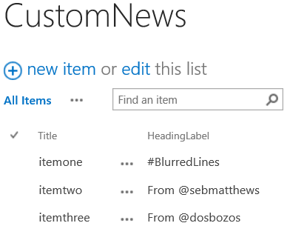
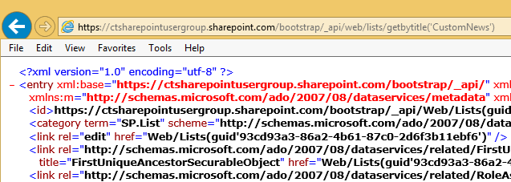


Working with REST
Since REST uses HTTP methods you can test your queries in the browser
https://ctsharepointusergroup.sharepoint.com/bootstrap/_api/Web/Lists/GetByTitle('CustomNews')
Notes:
Jared to hop in real quick

Slide 41
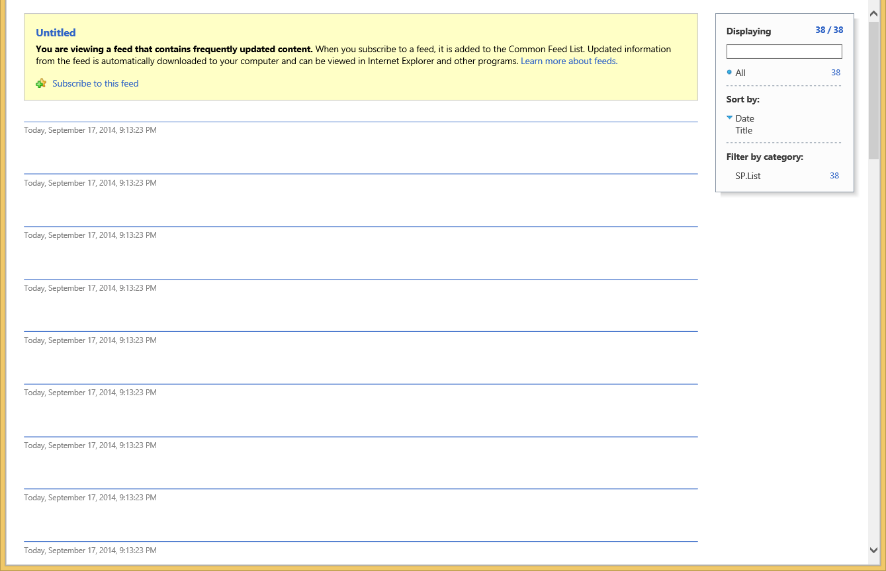
Working with IE (shudder)
Not helpful
Notes:
Jared

Slide 42
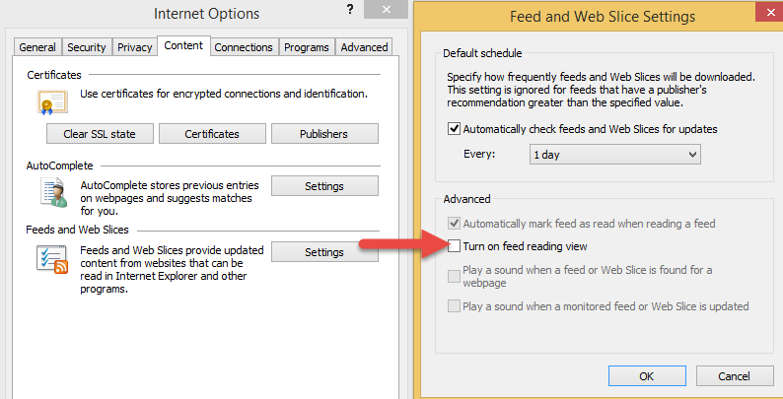
Let’s fix that right quick!
Notes:
Jared

Slide 43
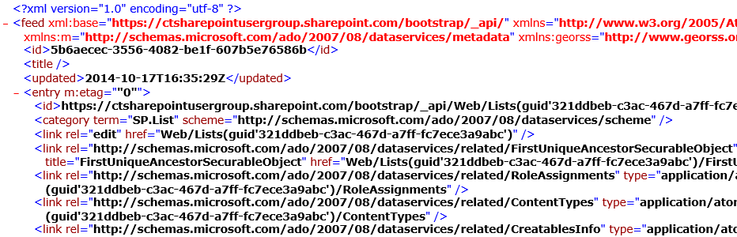
This is way more helpful!
Notes:
Basically what you’re seeing here is SharePoint spitting back XML of all the Lists in the CTSPUG.ORG O365 site.. (plz don’t hack us)

Slide 44
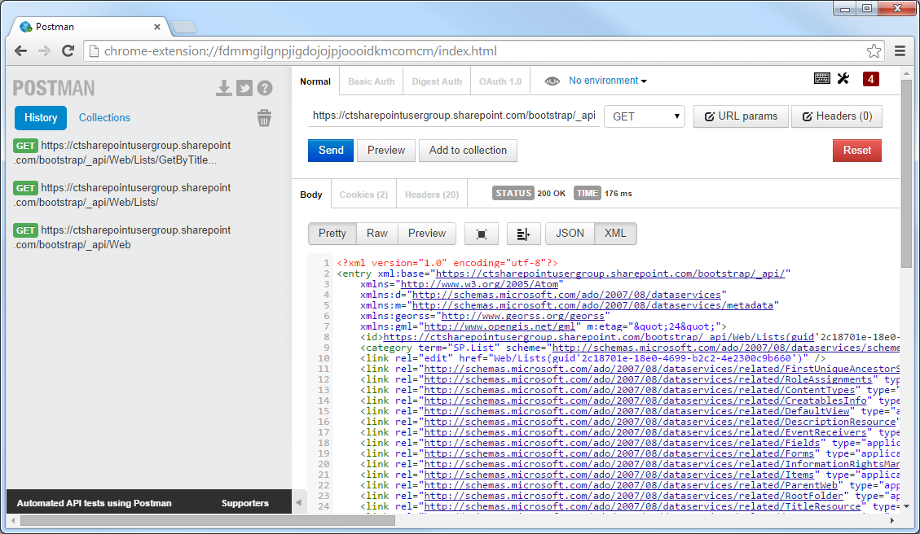
Better yet…
Postman REST Client for Chrome
Postman is Google Chrome extension that can be used to quickly create and test REST calls
Can execute different types of HTTP requests (GET, POST, DELETE, PATCH etc.)
Output can be “Raw” or “Pretty” for improved readability
http://www.getpostman.com

Slide 45
Creating Data using REST
  JavaScript with JQuery
  jQuery.ajax({
  url: “http://siteurl/_api/web/lists”,
  type: "POST",
  data: JSON.stringify({ '__metadata': { 'type': 'SP.List' }, 'AllowContentTypes': true, 'BaseTemplate': 100,
  'ContentTypesEnabled': true, 'Description': 'My list description', 'Title': 'Test' } ),
  headers: {
  "accept": "application/json;odata=verbose",
  "content-type":"application/json;odata=verbose",
  "content-length":length of post body
  "X-RequestDigest": $("#__REQUESTDIGEST").val()
  },
  success: doSuccess,
  error: doError
  });
Notes:
Chris picks it back up here

Slide 46
Updating Data using REST
  JavaScript with JQuery
  jQuery.ajax({
  url: “http://siteurl/_api/web/lists/GetByTitle(‘Test')”,
  type: "POST",
  data: JSON.stringify({ '__metadata': { 'type': 'SP.List' }, 'Title': 'New title' } ),
  headers: {
  “X-HTTP-Method”:”MERGE”,
  "accept": "application/json;odata=verbose",
  "content-type": "application/json;odata=verbose",
  "content-length":length of post body
  "X-RequestDigest": $("#__REQUESTDIGEST").val(),
  “IF-MATCH”: “*”
  },
  success: doSuccess,
  error: doError
  });

Slide 47
Putting it All Together for a Simple Example
Create a Document Library called Scripts and enable Versioning
Download a copy of jQuery and upload to Scripts library
Create a .txt file in your favorite code editor that contains or links to your HTML, CSS, and JavaScript
Add an empty Content Editor Web Part (CEWP) to any SharePoint Page where you would like to put your content
Configure Content Editor Web Part (CEWP) to point at .txt file with code

Slide 48
Demo
$("#code").show();
Simple Example Reading Data and Displaying in Content Editor Web Part using jQuery

Slide 49
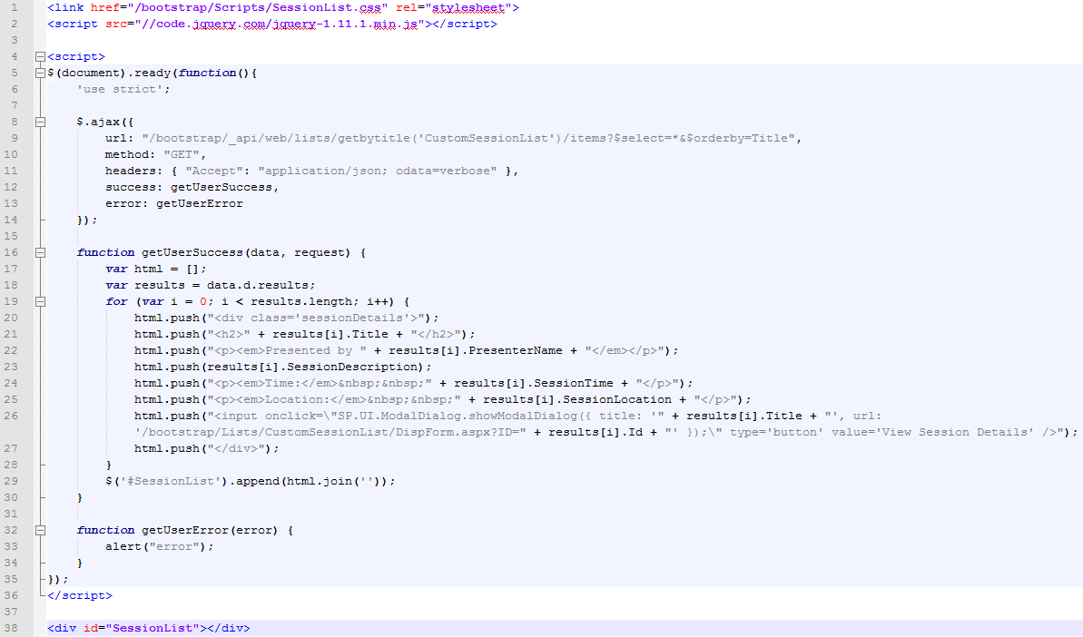
2
3
4
5
6
1

Slide 50
1
Add empty <div> to page with unique ID
HTML will be dynamically be written to <div> later using JavaScript

Slide 51
2
Add custom CSS reference
Add jQuery reference (local or CDN)

Slide 52
3
Use jQuery’s $( document ).ready() to wait until the Document Object Model (DOM) for the page is ready for JavaScript code to execute
The ‘use script’ directive (introduced in ECMAScript 5) enforces rules / safeguards such as requiring variables to be declared before use

Slide 53
4
jQuery $.ajax call asynchronously executes REST call to get List data
Requested data format is JSON
Success or Error function is executed on completion

Slide 54
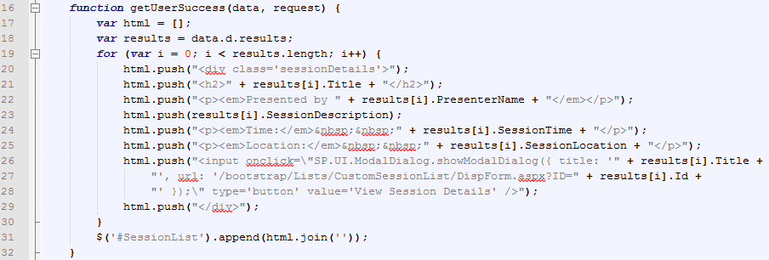
5
Success function initialized empty array to hold HTML that will be written to page
For loop iterates through all items and builds HTML
HTML is written to empty <div> on page

Slide 55
6
Error function will execute if an error is returned by the AJAX call
Displaying a JavaScript alert that says “error” is not a best practice ☺

Slide 56
Branding / BootStrap
Figuring out where to go with all those libraries & frameworks
Notes:
** Jared to talk **
Bootstrap is a combination of CSS & Javascript libraries

Slide 57
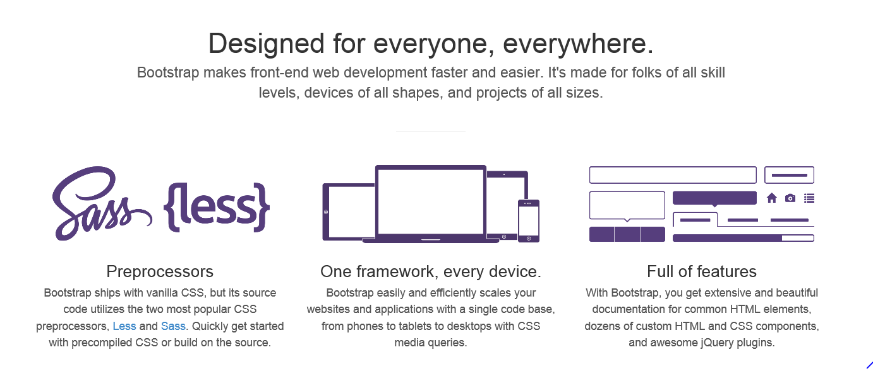
Bootstrap
Notes:
Jared talking
Bootstrap is a combination of CSS & Javascript libraries
Good to get a quick nice visual - still requires effort

Slide 58
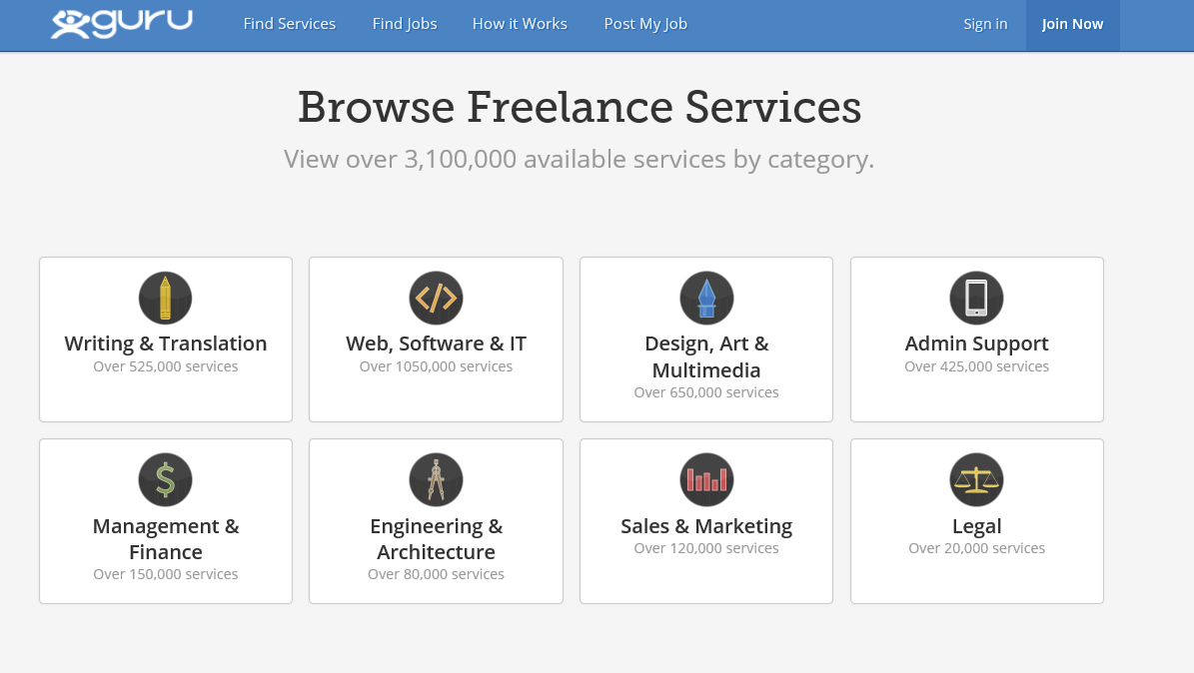
Bootstrap in action..
Notes:
You’ve seen it, and you might not even know it…

Slide 59
Putting it All Together for a Simple Example
Create an empty .ASPX page in the Site Pages library with SharePoint Designer
Download Bootstrap files and copy to SharePoint library
Copy Bootstrap boilerplate HTML code into .ASPX page
Update HTML content placeholders to have unique Ids
Add JavaScript (equivalent to previous demo)
Notes:
Chris speaking

Slide 60
Demo
$("#code").show();
Downloading Bootstrap and Creating Starter Page From Template

Slide 61
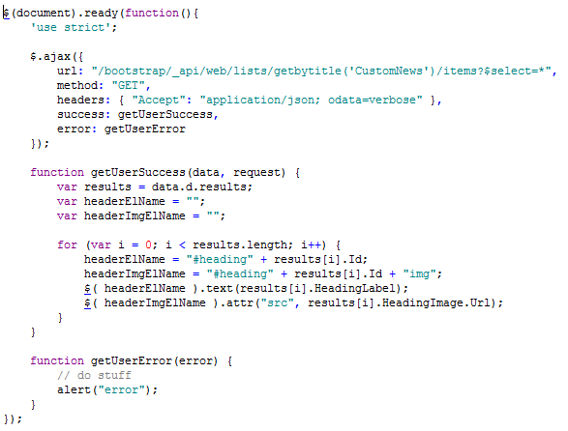
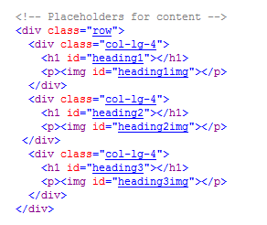
Code for Bootstrap Demo

Slide 62
Taking it a step further…
You can actually create a master page using Bootstrap
It can involve using Design Manager…

Slide 63
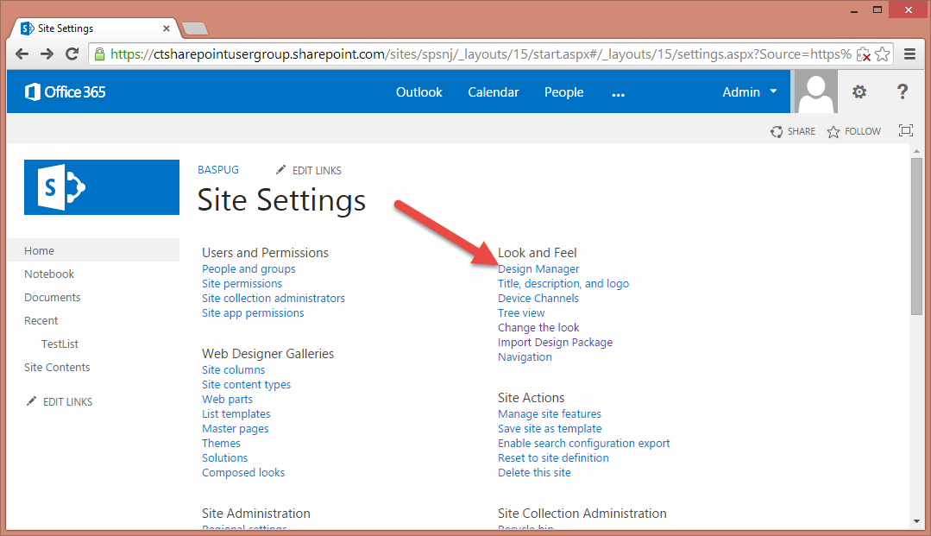
Open up Design Manager

Slide 64
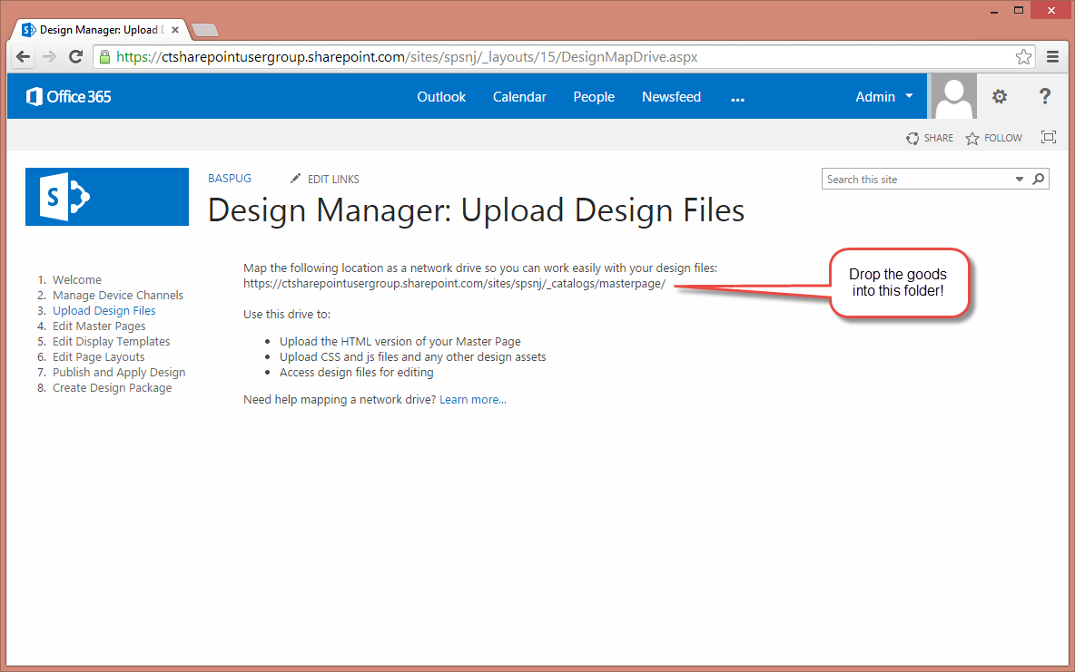
Upload Design Files

Slide 65
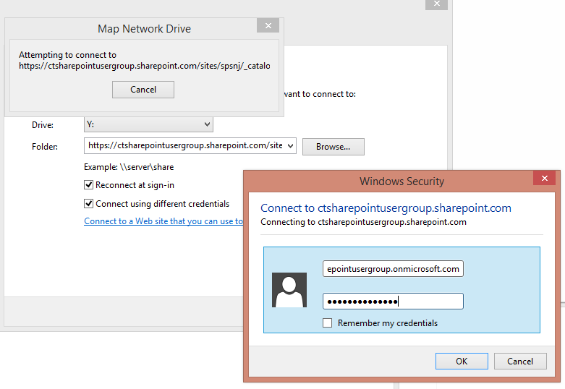
Map a network drive

Slide 66
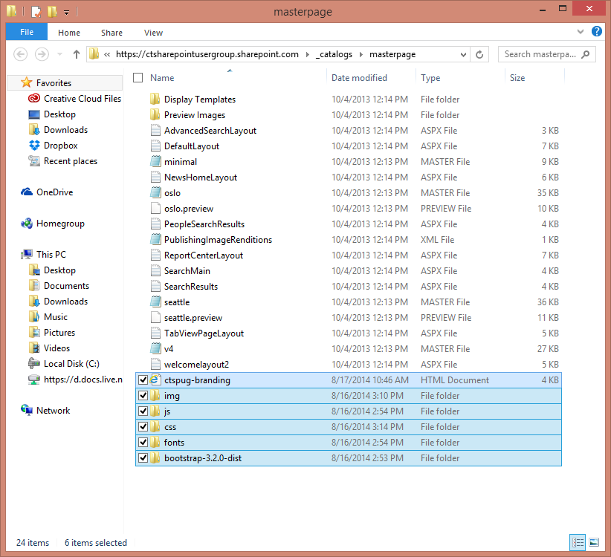
Drop your files in

Slide 67
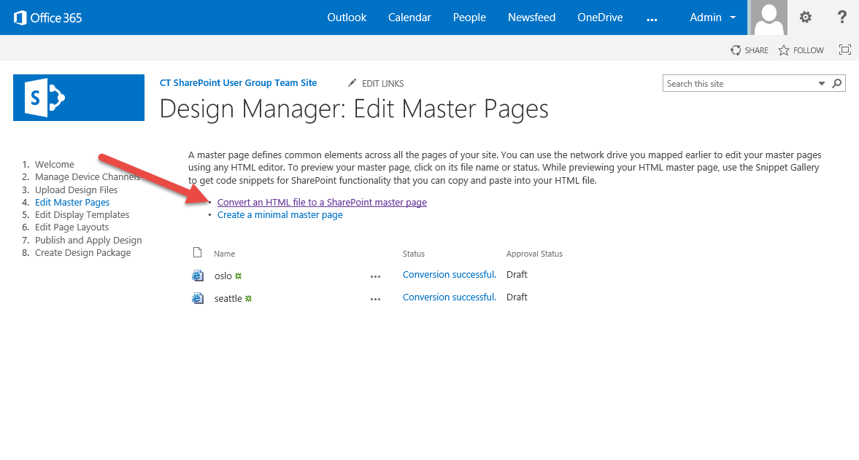
Convert an HTML file to Master Page

Slide 68
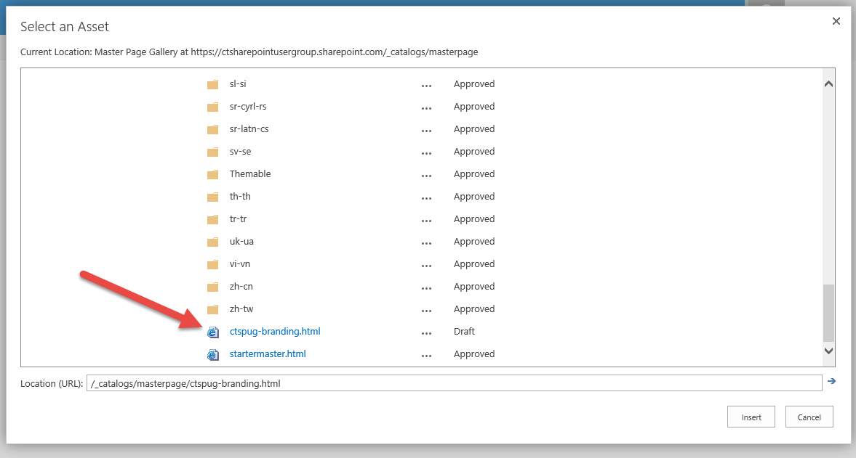
Find your HTML file

Slide 69
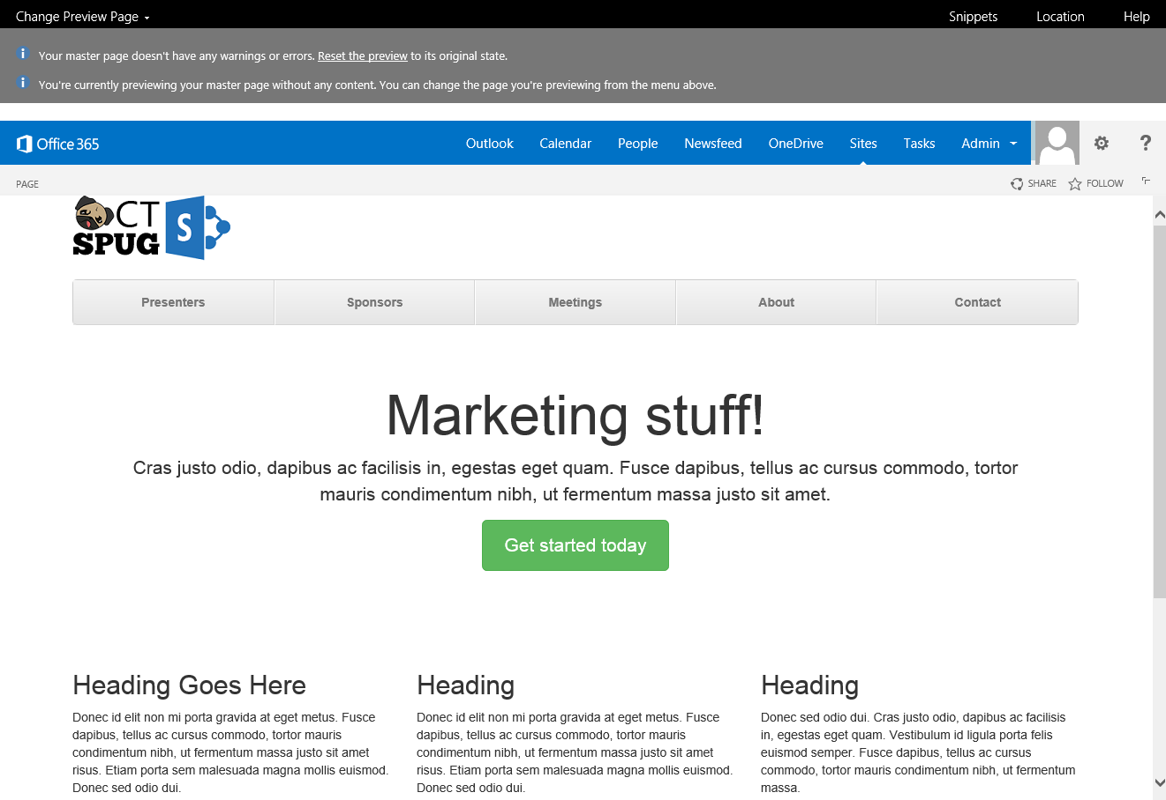
Preview your master page!

Slide 70
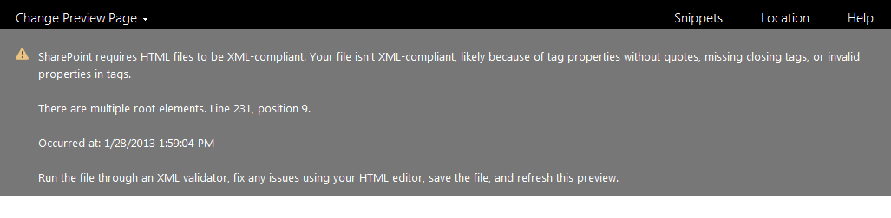
Pro Tip!
Watch out for XML validation issues with your design:
  <open tag></close tag> = works
  <tag stuff /> = not so much

Slide 71
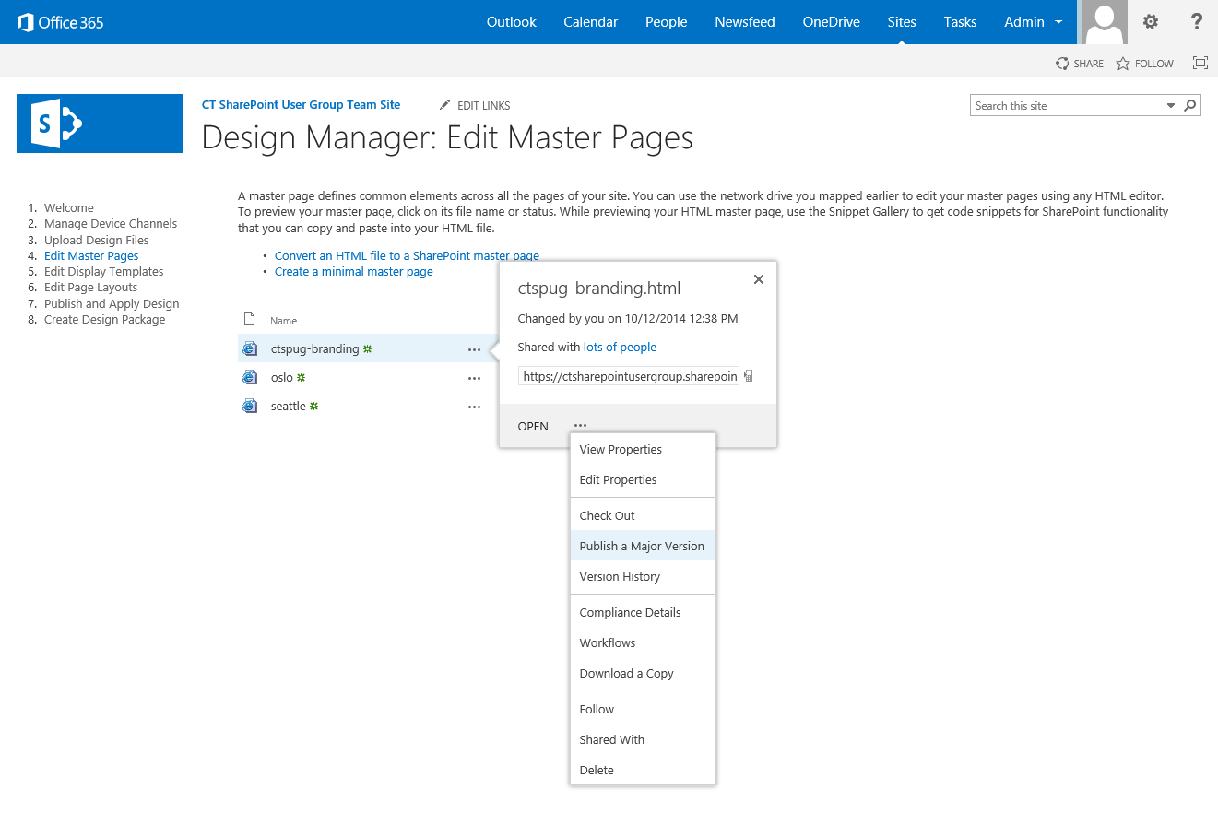
Publish a major version

Slide 72
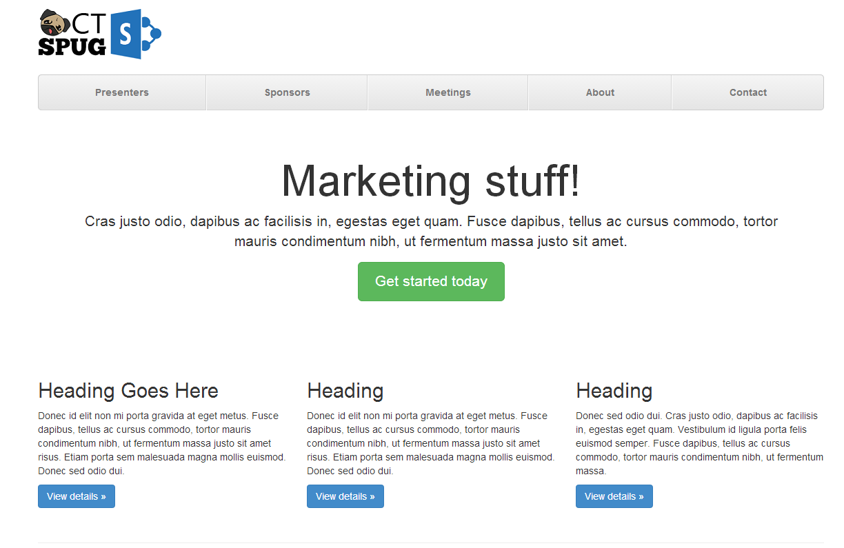
Quick mock-up in Bootstrap
Notes:
**

Slide 73
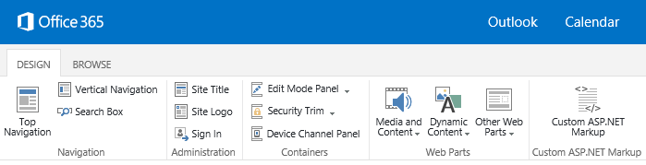
Next Steps!
Create a new page layout
Checkout the snippets menu to add some webpart zones
Don’t forget, you’re going to be updating the HTML file going forward and not the .master file
Be careful to not set your system master page as this new Frankenstein

Slide 74
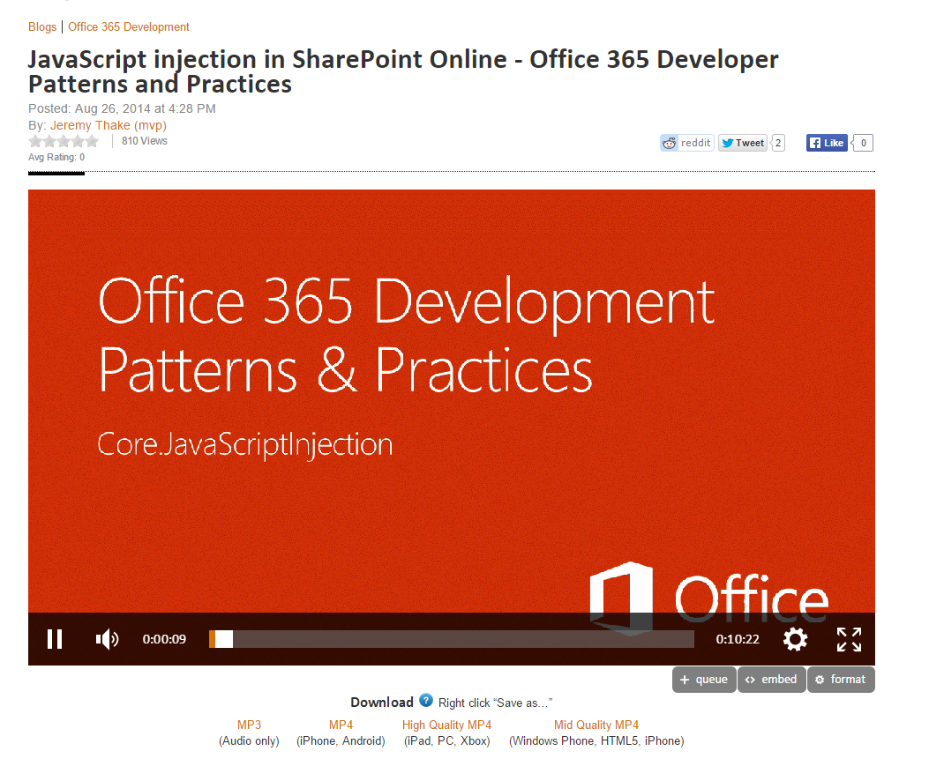
JavaScript Inject in SharePoint Online
http://channel9.msdn.com/Blogs/Office-365-Dev/JavaScript-injection-in-SharePoint-Online-Office-365-Developer-Patterns-and-Practices
Notes:
There’s been a lot of discussions about Microsoft recommending Javascript & CSS to introduce customizations for when Master Page editing was previously been used.
http://channel9.msdn.com/Blogs/Office-365-Dev/JavaScript-injection-in-SharePoint-Online-Office-365-Developer-Patterns-and-Practices

Slide 75
Client Side Rendering
Just a quick demo to show the possibilities

Slide 76
CSR – Client Side Rendering
Another cool way to inject JavaScript into the page
JS Link – a new web part property under Miscellaneous
Need to reference your script file as either:
  ~site/_catalogs/masterpage/CSR/myscript.js
  ~sitecollection/_catalogs/masterpage/CSR/myscript.js
  ** These are URL tokens don’t replace site or sitecollection, those are real values**

Slide 77
Three Override Techniques for JSLink
Pre-Render – modify the client-side data prior to it being rendered on the page
Overrides – override the field or item on the page as being rendered
Post-Render – after page is rendered make DOM manipulations

Slide 78
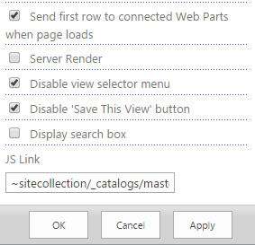
Where do you set it?

Slide 79
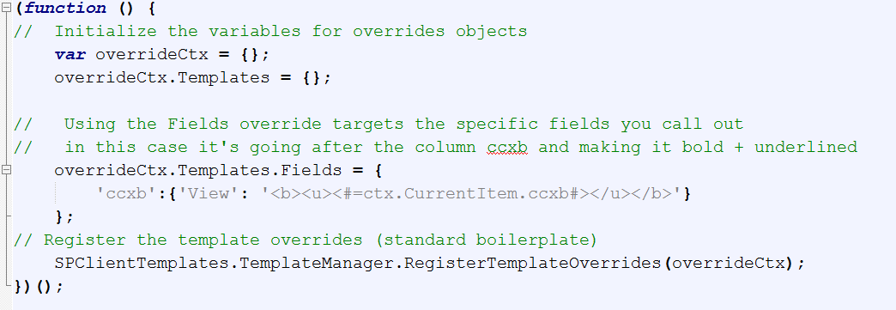
Contents of JavaScript file
Notes:
(function () {
// Initialize the variables for overrides objects
var overrideCtx = {};
overrideCtx.Templates = {};
// Using the Fields override targets the specific fields you call out
// in this case it's going after the column ccxb and making it bold + underlined
overrideCtx.Templates.Fields = {
'ccxb':{'View': '<b><u><#=ctx.CurrentItem.ccxb#></u></b>'}
};
// Register the template overrides (standard boilerplate)
SPClientTemplates.TemplateManager.RegisterTemplateOverrides(overrideCtx);
})();

Slide 80
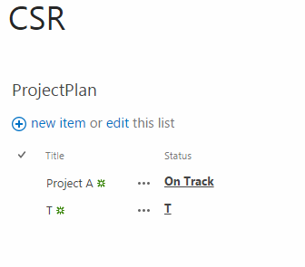
The result
Demo if time permits..

Slide 81
Training / Resources
Helpful tools and resources for learning JavaScript Development

Slide 82



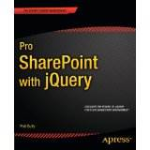
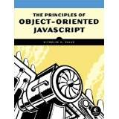







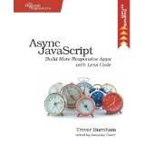


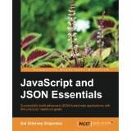


Books, books, and more books...
Notes:
Jared / Chris both talk about books

Slide 83
Helpful Pluralsight Courses
Developing SharePoint 2013 Solutions with JavaScript
http://www.pluralsight.com/courses/developing-sharepoint-2013-javascript
SharePoint 2013 Development: Client Object Model & REST API
http://www.pluralsight.com/courses/sharepoint-2013-client-object-model-rest
JavaScript “The Good Parts”
http://www.pluralsight.com/courses/javascript-good-parts

