Slide 1
Beginning SharePoint Development with JavaScript, AJAX, Bootstrap, and more..
Jared Matfess & Chris LaQuerre

Slide 2

New Jersey SharePoint user group
Different SharePoint discussions each month on various topics. Announced on meetup.com
Meets 4th Tuesday of every month
6pm – 8pm
Microsoft Office (MetroPark)
101 Wood Ave, Iselin, NJ 08830
http://www.njspug.com

Slide 3
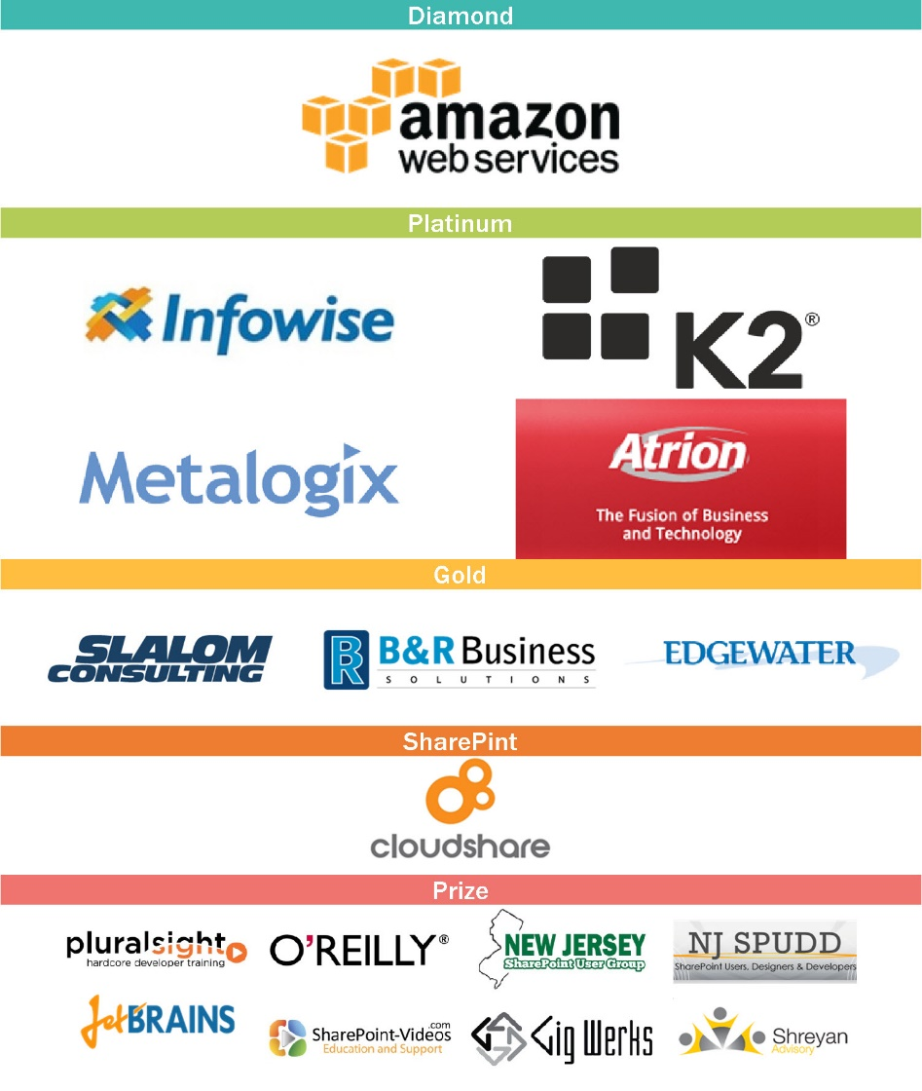
Thank You Event Sponsors
Diamond & Platinum sponsors have tables here in the Fireside Lounge
Please visit them and inquire about their products & services
Also to be eligible for prizes make sure to get your bingo card stamped

Slide 4
What we’ll cover today
JavaScript in Content Editor Web Part (CEWP)
JavaScript in an ASPX page – created in SharePoint Designer (SPD)
REST – CRUD operations
Bootstrap – just the basics
Session Goals
Provide enough information for you to get started with a few basic examples to get past the initial learning curve
Focus on approaches that can be utilized by a Site Owner in SharePoint 2010 / 2013 on premise or Office 365 without the App model

Slide 5

Session warning
This session is awesome
There will be some code
There will be awesome demos

Slide 6

About Jared
SharePoint Consultant with Slalom Consulting
10+ years in the IT Field, 0 book deals
President of CT SharePoint Users Group (www.ctspug.org)
Blog: www.jaredmatfess.com
Twitter: @JaredMatfess
E-mail: JaredM@slalom.com

Slide 7

About Chris
SharePoint Lead at Saint Francis Hospital
15+ years IT experience
Got married in April
Not president of CT SharePoint Users Group (www.ctspug.org)
Author of SharePoint 2013 Web Analytics Data Export CodePlex project
  http://sp2013wade.codeplex.com

Slide 8


About Schmidt
Great movie starring Jack Nicholson
Has nothing to do with our presentation
Spoiler Alert: Kathy Bates skinny dips in a hot tub

Slide 9
Demo
$("#code").show();
“Here’s where it gets awesome..” –This Guy

Slide 10

So why Client Side Development?
Why JavaScript?
Notes:
Jared

Slide 11

SharePoint “upgrades” are terrible
Notes:
Conversation about upgrading SharePoint is a real pain..And you might be
Microsoft MVP, Works for Rackspace
SharePoint Admin Netcast
Quick Todd Klindt shout-out – Mondays @ 8:30 PM CST – http://www.toddklindt.com

Slide 12
The pain..
Migrating lots of old data
The fight to define (or justify) Information Architecture
The G-Word (Governance)
Technology – acquiring the hardware
Addressing the Customizations
Notes:
All that server side code..
Branding
Missing source code
Elevation of privs to the farm account - can do whatever it wants
Consumes less resources on the server (javascript)
Brings down the environment – 55 WSP’s @ old company

Slide 13

Does it need to be server side code?
Server Side Code
  Timer jobs
  Custom site definitions
  3rd party products where you have no choice
  Custom workflows (when you don’t own Nintex or K2)
Client Side Code
  Everything else
Notes:
*** Back in the day the thinking was server side first, and client side “maybe” ***
** Today’s thinking – Client Side first **
If the answer is No – go client side..
Default client side – vs old model of defaulting server side

Slide 14

The big M(icrosoft)
O365 is Microsoft’s “Cash Cow”
You cannot deploy server-side code to O365
MSFT is rolling out features to O365 first
  On premises second
The client side API’s are getting better!
Everybody’s doing – JavaScript is blowing up

Slide 15
There’s a library/framework for that…
Figuring out where to go with all those libraries & frameworks
Notes:
Still Jared **

Slide 16

JavaScript
Notes:
Before we get into frameworks, let’s talk about Javascript.
JavaScript is like that nerd (or maybe it was you) that asked you out a million times to prom. Long-term you know it would be good for you.. That nerd would grow up, get a great job, be able to provide for you.. By man oh man, did that C# Server Side code look good at the time.. You were a hot commodity, recruiters couldn’t throw money at you fast enough to churn out those webparts that displayed Dilbert cartoons, stock tickers, all that other nonsense.
First class citizen in SHarePoint Development

Slide 17
Benefits of JavaScript
SharePoint Admins are happy to get those WSP’s out of their farm
Developers are happy because they can deploy new functionality without those grumpy SharePoint Admins
JavaScript skills translate to other opportunities outside of SharePoint

Slide 18








It’s starting to feel a lot like NASCAR
Notes:
***Thousands of JavaScript libraries / frameworks are available to facilitate development of JavaScript-based applications
*** Wikipedia’s list of “notable” JavaScript libraries contains 65 items

Slide 19
Our recommendation for beginners…
Here are the frameworks / libraries that I’d like to talk about:
JavaScript
jQuery
  Most of the code samples you'll find on the web use jQuery
Bootstrap
*As advertised in the session description ☺

Slide 20
jQuery
jQuery is the most popular JavaScript library in use today
  Used by over 60% of the 10,000 most visited websites
  It’s probably in your environment and you don’t even know it
Greatly simplifies cross-browser client-side scripting of HTML
  Handles compatibility issues with older browsers (ex: IE6 / IE7 / IE8)
Most SharePoint code examples on the internet use jQuery
Notes:
Chris starts speaking

Slide 21
Where do I put my scripts?
Option #1 | Place code directly in Content Editor Web Part (CEWP) Not so good
Option #2 | Create a “Scripts” library and put them there – much better Enable Versioning (just in case)
Option #3 | Drop it in the hive (on premise only)? Only if you want to dance with danger
Option #4 | Bundle with a SharePoint App (2013 only)

Slide 22
What tools do I need to write code?
Your favorite text editior (ex: NotePad ++)
Visual Studio
Sublime
Web Storm
Emacs or Vim for the hardcore
The list goes on and on…
Notes:
Chris speaks to this slide

Slide 23
What tools do I need to troubleshoot code?
Internet Explorer F12 Developer Tools
Chrome Developer Tools
Firefox / Firebug
Fiddler
Notes:
Chris speaks to this slide

Slide 24
REpresentational State Transfer (REST)
Figuring out where to go with all those libraries & frameworks
Notes:
** Chris is REST-less **

Slide 25
REST Fundamentals
The term representational state transfer was introduced and defined in 2000 by Roy Fielding in his doctoral dissertation at UC Irvine
What is REST or RESTful?
  Representational State Transfer – is that helpful?
  A RESTful service adheres to the 4 basic design principals outlined in Fielding’s dissertation
Often times referred to as an alternative to SOAP

Slide 26
REST Design Principles
Four basic design principles:
  Use HTTP methods explicitly (POST, GET, PUT, DELETE)
  Be stateless
  Expose directory structure-like URIs
  Transfer XML, JavaScript Object Notation (JSON), or both

Slide 27
Reading Data using REST / jQuery
  JavaScript with jQuery
  $.ajax({
  url: "http://siteurl/_api/web/lists",
  type: "GET",
  headers: {
  "ACCEPT": "application/json;odata=verbose"
  },
  success: doSuccess,
  error: doError
  });

Slide 28
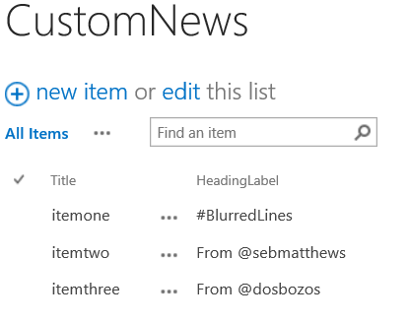
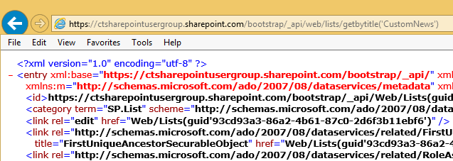


Working with REST
Since REST uses HTTP methods you can test your queries in the browser
https://ctsharepointusergroup.sharepoint.com/bootstrap/_api/Web/Lists/GetByTitle('CustomNews')
Notes:
Jared to hop in real quick

Slide 29
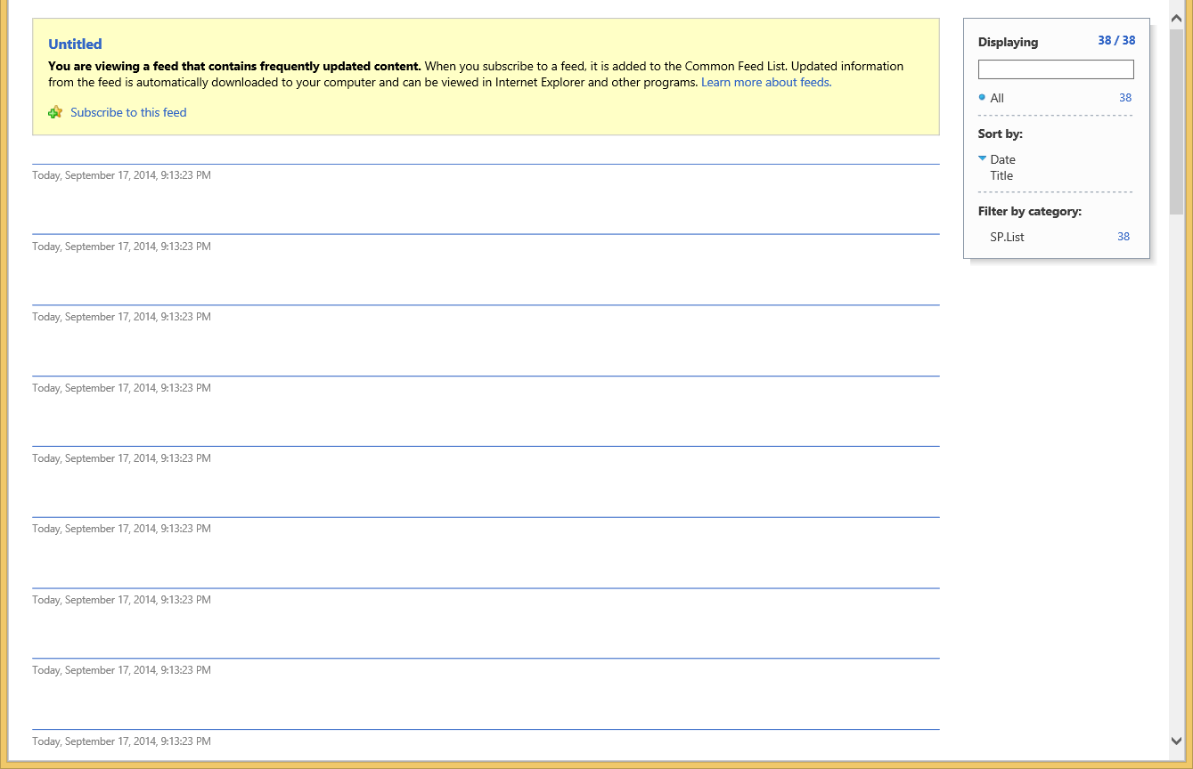
Working with IE (shudder)
Not helpful
Notes:
Jared

Slide 30
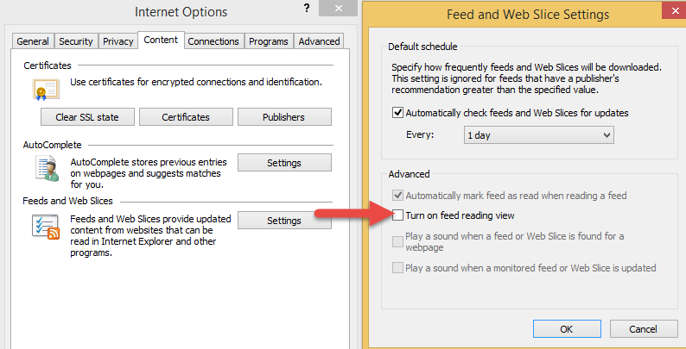
Let’s fix that right quick!
Notes:
Jared

Slide 31
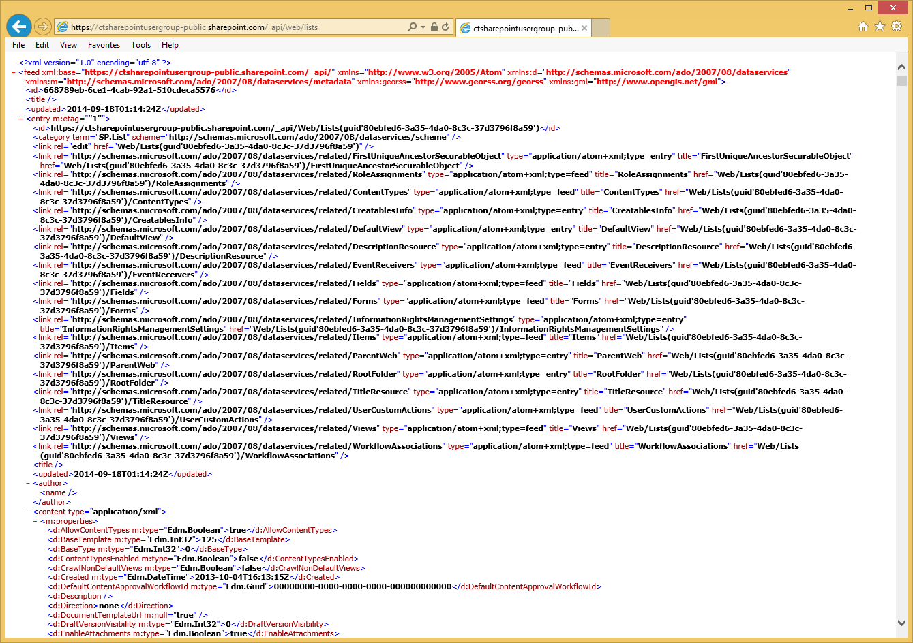
This is way more helpful!
Notes:
Basically what you’re seeing here is SharePoint spitting back XML of all the Lists in the CTSPUG.ORG O365 site.. (plz don’t hack us)

Slide 32
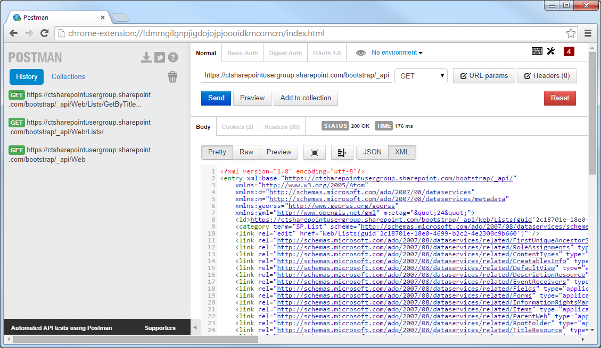
Better yet…
Postman REST Client for Chrome
Postman is Google Chrome extension that can be used to quickly create and test REST calls
Can execute different types of HTTP requests (GET, POST, DELETE, PATCH etc.)
Output can be “Raw” or “Pretty” for improved readability
http://www.getpostman.com

Slide 33
Creating Data using REST
  JavaScript with JQuery
  jQuery.ajax({
  url: “http://siteurl/_api/web/lists”,
  type: "POST",
  data: JSON.stringify({ '__metadata': { 'type': 'SP.List' }, 'AllowContentTypes': true, 'BaseTemplate': 100,
  'ContentTypesEnabled': true, 'Description': 'My list description', 'Title': 'Test' } ),
  headers: {
  "accept": "application/json;odata=verbose",
  "content-type":"application/json;odata=verbose",
  "content-length":length of post body
  "X-RequestDigest": $("#__REQUESTDIGEST").val()
  },
  success: doSuccess,
  error: doError
  });
Notes:
Chris picks it back up here

Slide 34
Updating Data using REST
  JavaScript with JQuery
  jQuery.ajax({
  url: “http://siteurl/_api/web/lists/GetByTitle(‘Test')”,
  type: "POST",
  data: JSON.stringify({ '__metadata': { 'type': 'SP.List' }, 'Title': 'New title' } ),
  headers: {
  “X-HTTP-Method”:”MERGE”,
  "accept": "application/json;odata=verbose",
  "content-type": "application/json;odata=verbose",
  "content-length":length of post body
  "X-RequestDigest": $("#__REQUESTDIGEST").val(),
  “IF-MATCH”: “*”
  },
  success: doSuccess,
  error: doError
  });

Slide 35
Putting it All Together for a Simple Example
Create a Document Library called Scripts and enable Versioning
Download a copy of jQuery and upload to Scripts library
Create a .txt file in your favorite code editor that contains or links to your HTML, CSS, and JavaScript
Add an empty Content Editor Web Part (CEWP) to any SharePoint Page where you would like to put your content
Configure Content Editor Web Part (CEWP) to point at .txt file with code

Slide 36
Demo
$("#code").show();
Simple Example Reading Data and Displaying in Content Editor Web Part using jQuery

Slide 37
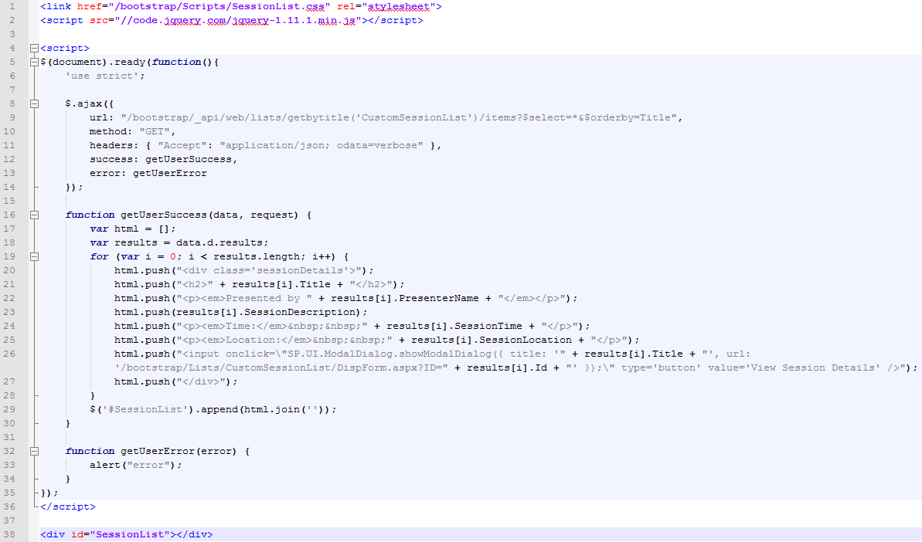
2
3
4
5
6
1

Slide 38
Branding / BootStrap
Figuring out where to go with all those libraries & frameworks
Notes:
** Jared to talk **
Bootstrap is a combination of CSS & Javascript libraries

Slide 39
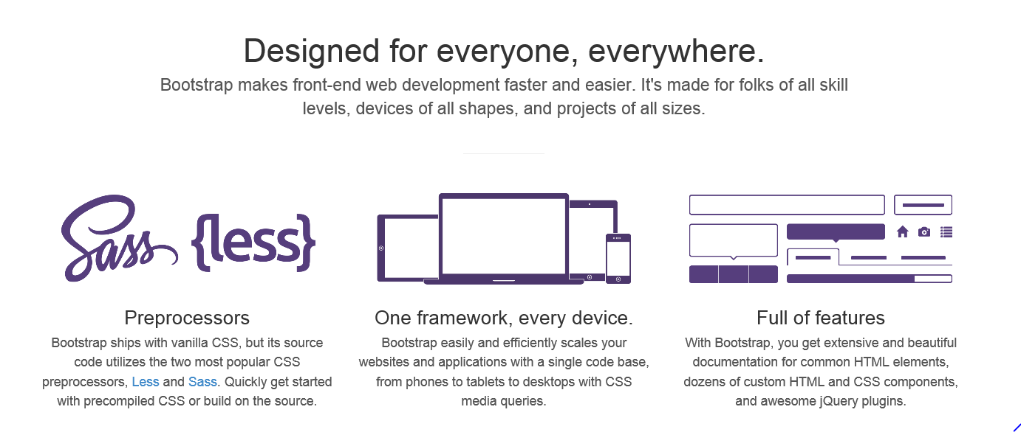
Bootstrap
Notes:
Jared talking
Bootstrap is a combination of CSS & Javascript libraries
Good to get a quick nice visual - still requires effort

Slide 40
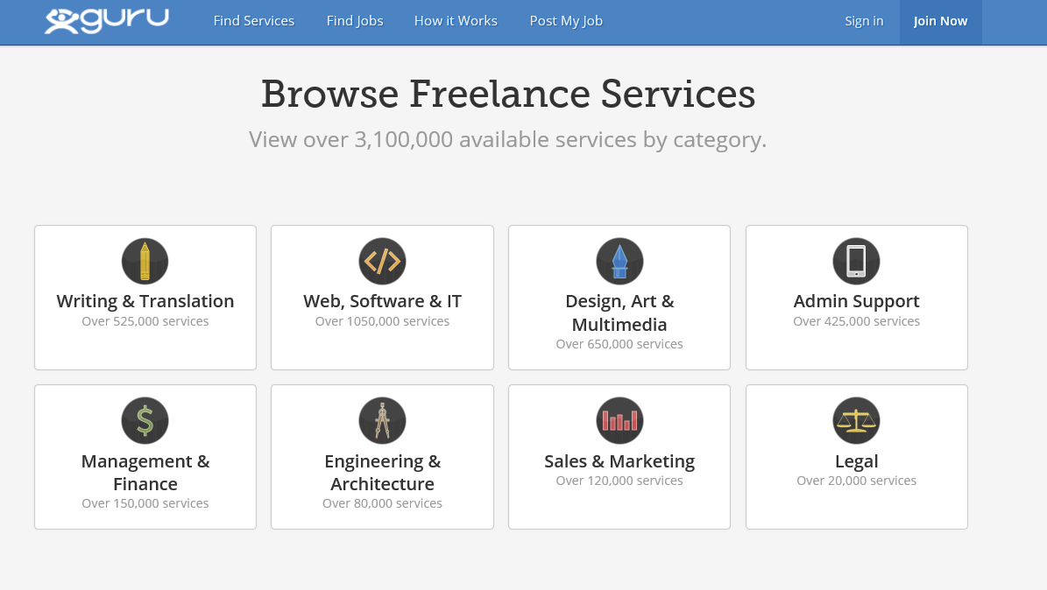
Bootstrap in action..
Notes:
You’ve seen it, and you might not even know it…

Slide 41
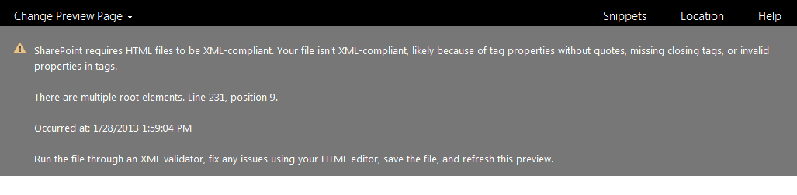
Pro Tip!
Watch out for XML validation issues with your design:
  <open tag></close tag> = works
  <tag stuff /> = not so much

Slide 42
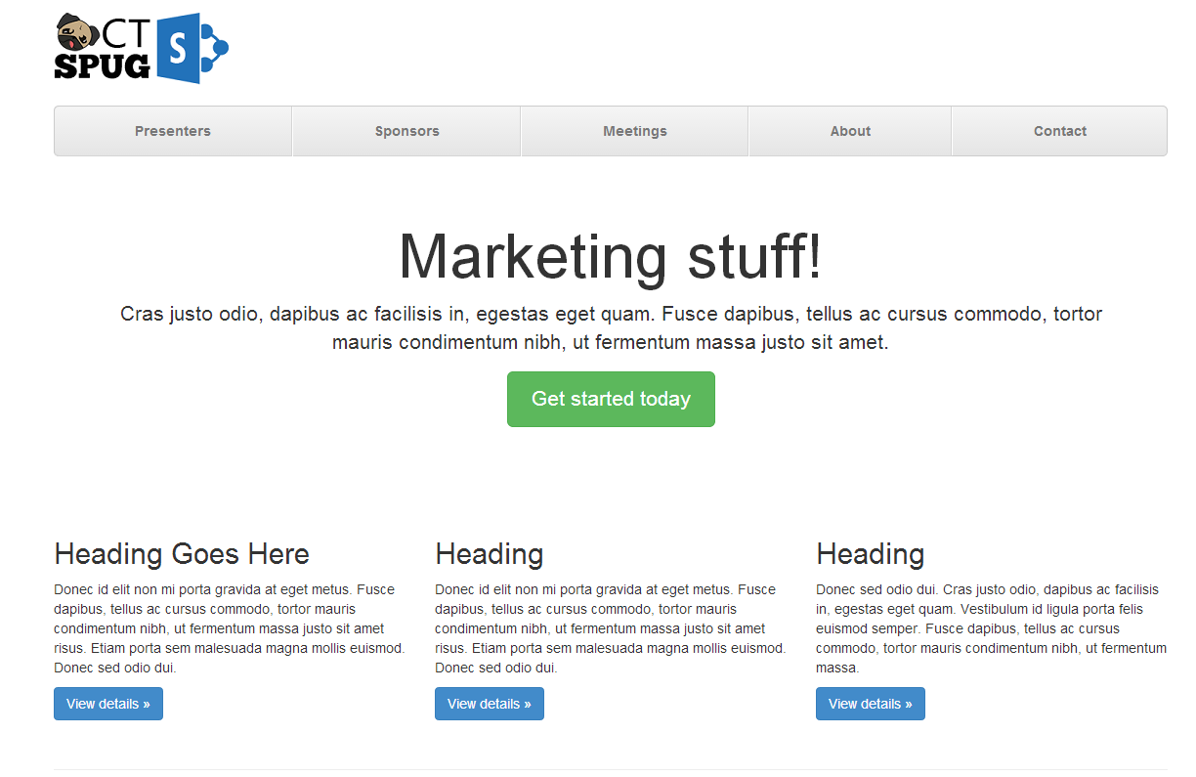
Quick mock-up in Bootstrap
Notes:
**

Slide 43
Putting it All Together for a Simple Example
Create an empty .ASPX page in the Site Pages library with SharePoint Designer
Download Bootstrap files and copy to SharePoint library
Copy Bootstrap boilerplate HTML code into .ASPX page
Update HTML content placeholders to have unique Ids
Add JavaScript (equivalent to previous demo)
Notes:
Chris speaking

Slide 44
Demo
$("#code").show();
Downloading Bootstrap and Creating Starter Page From Template

Slide 45
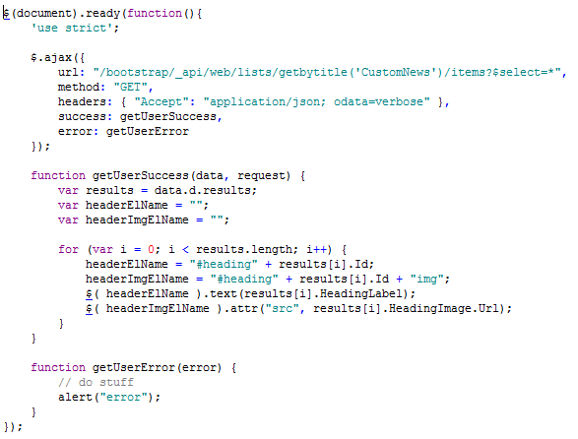
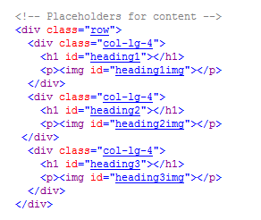
Code for Bootstrap Demo

Slide 46
Training / Resources
Helpful tools and resources for learning JavaScript Development

Slide 47



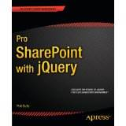
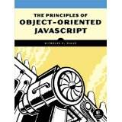

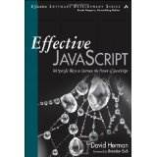





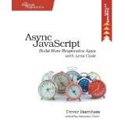


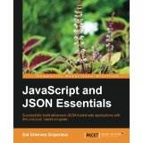
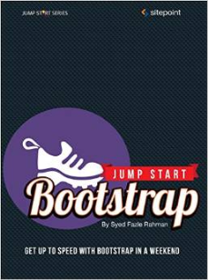

Books, books, and more books...
Notes:
Jared / Chris both talk about books

