Slide 1
Yes we can!
Enabling Collaboration in a Locked Down SharePoint Environment!
Jared Matfess
Consultant, Slalom Consulting
#SPSBMORE

Slide 2


The Problem with SharePoint
Establishing your Data Protection Plan
Building blocks for your Solution
Summary

Slide 3

About Me
SharePoint Consultant with Slalom Consulting
10+ years in the IT Field, 0 book deals
President of CT SharePoint Users Group (www.ctspug.org)
Blog: www.jaredmatfess.com
Twitter: @JaredMatfess
E-mail: Jared.Matfes@outlook.com

Slide 4
My Background
Worked 11 years at United Technologies Corporation
Started in Communications as a co-op
SharePoint, Infrastructure, Networking, Project Management, eBusiness
Designed their US/FN collaboration solution for non-technical data collaboration
Notes:
We had a 200,000 person implementation – around 50% of our company is overseas
60+ servers
Large implementation
This stuff isn’t easy

Slide 5
Presentation Background
SharePoint has the potential to drastically disrupt the normal operations for large corporations
Navigating the political/social stigma of a collaborative technology in a regulated industry can be fun
Here are some best practices, lessons learned, and tips for your own implementation
Notes:
We had a 200,000 person implementation – around 50% of our company is overseas
60+ servers
Large implementation
This stuff isn’t easy

Slide 6
The Problem with SharePoint
“The days when it isn’t awesome”

Slide 7


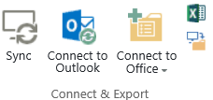
SharePoint
SharePoint makes it almost too easy to share files
  Upload, Sync, Drag & Drop, Open in Explorer
  Multiple devices supported
It also includes Share in the name! ☺

Slide 8
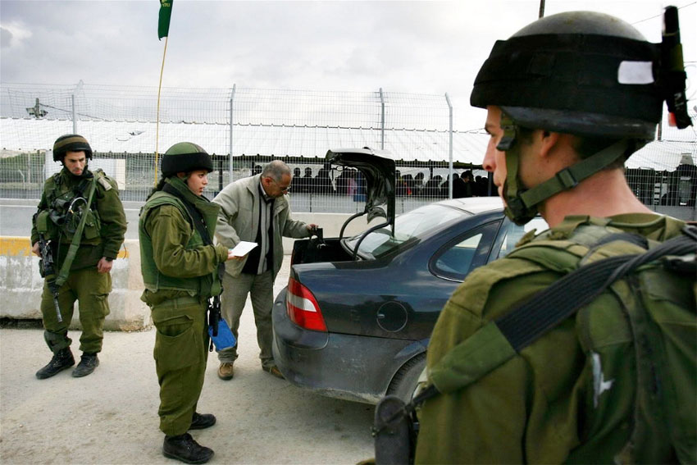
What your CSO wants for SharePoint

Slide 9

What your users want

Slide 10
Why do mistakes happen?
People – someone shares a file with someone who shouldn’t see it
Process – the process for sharing data failed
Technology – there weren’t adequate controls in place to enable to required collaboration while including mistake proofing steps

Slide 11
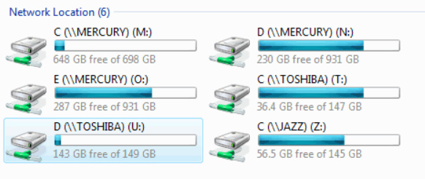
Where am I?
File shares are very ambiguous and lead to mistakes
Users might understand the title but not the purpose for the share
How would a user know the difference between the N & O Drives?

Slide 12

What matters to your users?
Would Carl purposely upload a sensitive document to an open SharePoint site?

Slide 13
Establishing your data protection plan

Slide 14
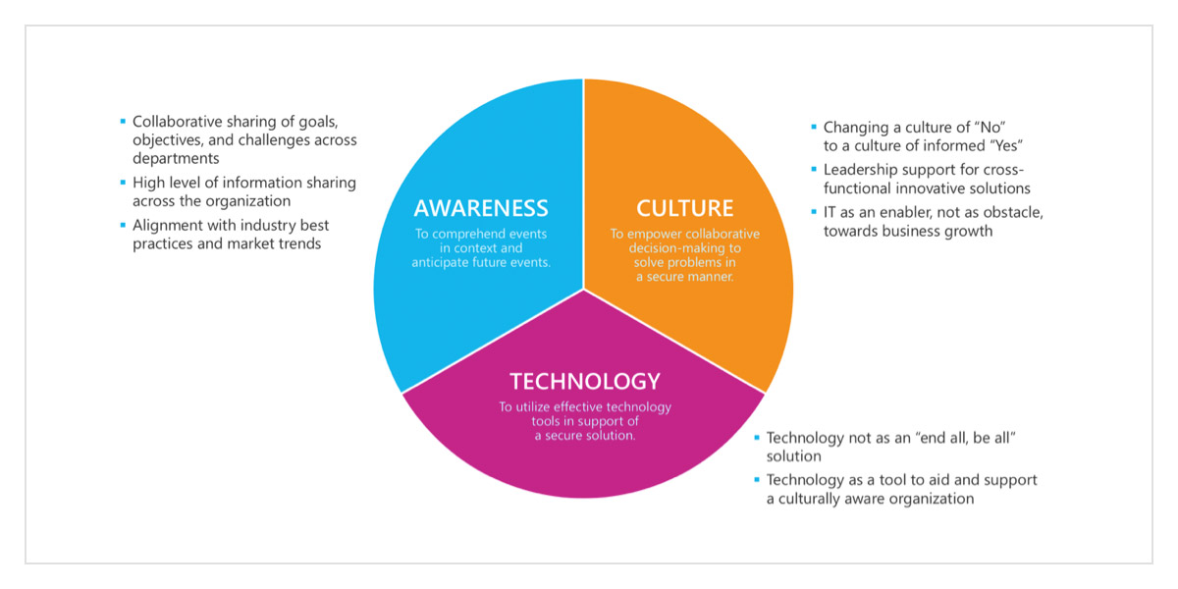
A.C.T. – The Keys to Success
Notes:
Awareness is the ability of individuals within an organization to socialize, discuss, and comprehend current tactical and strategic events in context and appropriately anticipate potential future events for the purposes of developing secure, realistic, and actionable solutions.
Culture is the ability of an organization to support its employees to resist operational complacency and to empower them to make collaborative, risk-based decisions and solve high-value problems in a secure and cost-effective manner.
Technology is the ability of an organization to utilize and implement effective technology tools in support of a comprehensive secure solution within a culturally aware organization.

Slide 15
What are your data concerns?
Intellectual property?
Company private/sensitive such as salary planning?
Mergers and acquisitions data which could impact stock price?
Are the concerns regulatory? HIPPA, Export Control, PII?
Are there retention policies surrounding your data?
Notes:
SharePoint 2010+ is not certified with DoD 5015.2
Microsoft recommends adding one of their partners to your SharePoint solution
It can be secured – it is HIPPA compliant

Slide 16

You need to engage your business!
Information Technology Security
Compliance
Legal
Human Resources
Notes:
You can’t do a major data protection project without engaging your business. They know their data!

Slide 17

Your goal – guide your users to success
Notes:
You want to guide your users to the intended goal – you want them to be able to collaborate with their colleagues. Enabling innovation is what will continue to drive your company to success.

Slide 18

Define your data security requirements
Identify logging/auditing requirements
Target the data which needs to be secured
  Leverage existing DRM technology
  Force data classification on data upload
User / data separation requirements

Slide 19
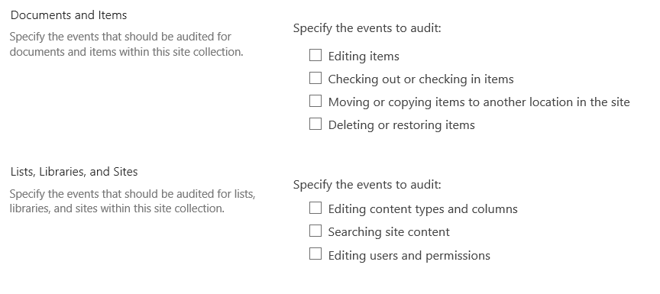
What do you want to audit?

Slide 20
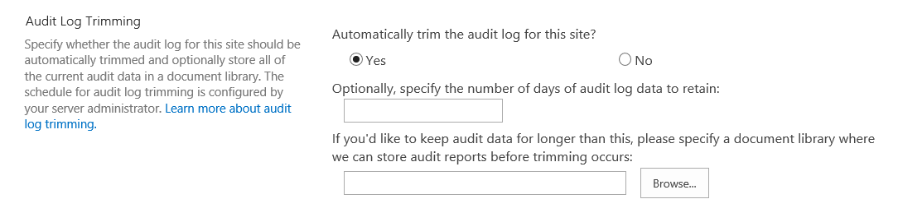
How long do you want to keep the data?
Recommend enabling audit trimming
Consider 3rd party solution such as AvePoint Report Center for long-term archiving / reporting on audit data
Notes:
OOB Audit retention is 30 days

Slide 21
Reporting
Try to map your user requirements to relevant reports
Help drive the audit discussion so you can help shape the report outputs
Consider custom applications built on-top of SharePoint
Consider a 3rd party vendor: AvePoint, HarePoint, Metalogix, WebTrends based on requirements

Slide 22
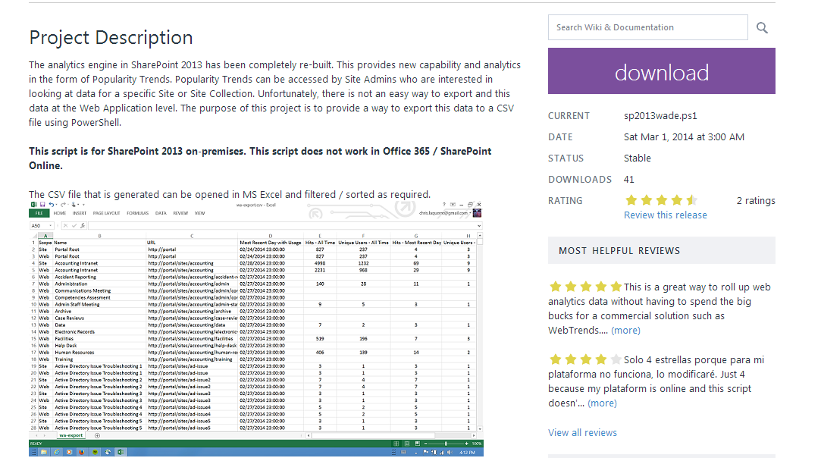



Web Analytics to CSV CodePlex Project!
Chris LaQuerre
VP, CTSPUG
https://sp2013wade.codeplex.com/

Slide 23
Building blocks for your solution
Tips & tricks from the field

Slide 24
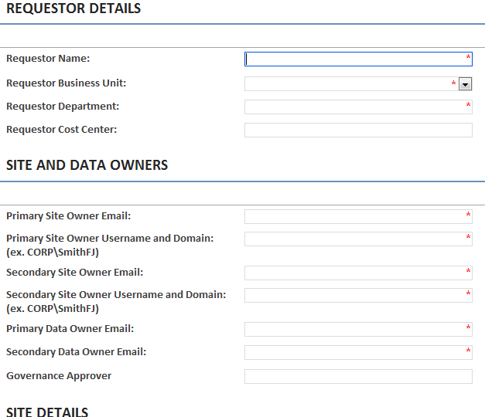
Start at your site request process
Identify your decision making questions
Capture key field as metadata
  Store in site collection property bag
  Also consider hidden list in site collection
Meet with your customers to understand
what they are requesting
Notes:
*Hidden lists are good because they can

Slide 25
Powershell to create custom property
Powershell to add a custom entry CTSPUG President to the property bag
$site = New-Object Microsoft.SharePoint.SPSite("http://www.ctspug.org")
$rootWeb = $site.RootWeb
$rootweb.AllowUnsafeUpdates = $true
$rootweb.Properties.Add("CTSPUG President", "Jared Matfess")
$rootweb.Update()
Consider including this to your Site Collection creation process

Slide 26
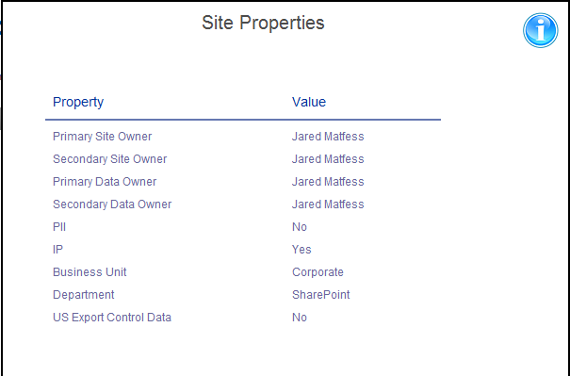

Expose Site Metadata to Users
Display data captured during site collection process
Ensure you have process for keeping data current
Great post!
Jeremy Thake
http://goo.gl/emfLVi
Notes:
Jeremy Thake put out a great post on how to read property bag using CSOM

Slide 27
Data Separation by Web Application
SharePoint Farm
US Person Web Application
Foreign Person Web Application
Executive Only Web Application
Notes:
When building your SharePoint environment you can consider creating logical separation within the SharePoint environment. Establishing key boundaries for what type of collaboration is allowed in a particular area.

Slide 28
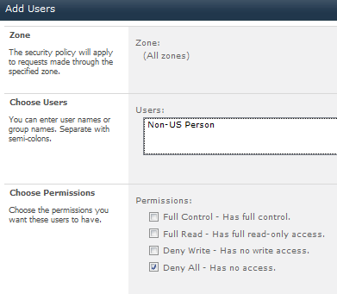
Technical Implementation
Created web applications and set user policies that would “Deny All” to users that did not meet the container requirements.
Relies on global Active Directory Groups such as “All Domain Users”

Slide 29
Dynamic groups leveraging claims
Consider having a developer create a custom claims provider
Claims at a high level are conditions you can establish about a user
Example: Marketing user claim can be established if Department = “Marketing”
Use these claims to prevent “Non-Executives” from accessing a web application
Great TechNet Article (written by Scot & Ted Pattinson)
http://msdn.microsoft.com/en-us/library/gg615945.aspx

Slide 30

Claims “Gotcha’s”
When setting any sort of “Deny All” consider your administrators and any service accounts that make SharePoint run!!
How clean is your Active Directory environment?
  Make sure your developers consider columns that might be NULL
  Perform some analysis on Active Directory data before building anything!
  What processes exist to keep user data accurate?

Slide 31
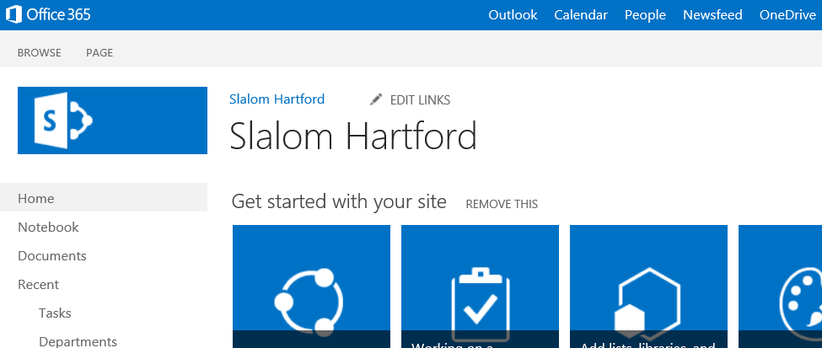
Mistake-proofing steps
Include visual cues to help inform users what is acceptable data
PII data is not allowed in this site

Slide 32
SharePoint Permissions
#1 Governance decision is who gets what access in SharePoint
Consider custom permissions / roles but be consistent
Example:
Role | Overview
Site Power User | Business Power User who owns the site
IT Power User | Non-SharePoint Team
Contributor (No Delete) | Business user
Web Analytics Viewer | Manager role who needs metrics

Slide 33

Who’s managing permissions?
Business Users are managing permissions
  Users can give other people “Full Control”
  Governance can get thrown out the window
IT is managing permissions
  Slows down adoption
  Someone has to “do the work”
  Hurts ad-hoc collaboration

Slide 34
Compromises
Try to only use Active Directory groups for permissions
  Rely on existing processes for populating those groups
Give business users “Manage Permissions” but rely on 3rd party tools or custom scripts to report on user access
  Hire a team to manage/oversee this ☺

Slide 35
Pro Tip: Group Owners can add users!
You can make your business users the owners for groups and allow them to add/remove individuals without manage permissions access!

Slide 36
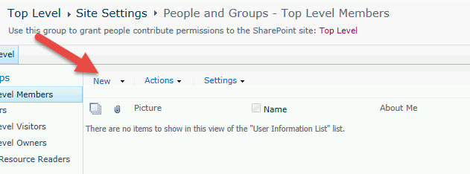
ProTip: (continued)
Navigate to the group from the site permissions screen and then add/remove the user from that screen

Slide 37

Manual vs Build vs Buy
Manual: Keep your processes & access tightly controlled
Build a custom solution:
  Event receivers on document upload
  Timer jobs to confirm configuration
  PowerShell scripts for reporting / Web Analytics
Buy: Partner with a 3rd party such as AvePoint / Metalogix / Hi Software

Slide 38
Prototype & scale it out
Great ideas can start with a SharePoint Designer Workflow
(but shouldn’t necessarily end with it in a large scale environment)
Work with users to prove out ideas and improve
Consider the implications when everyone is in the system

Slide 39
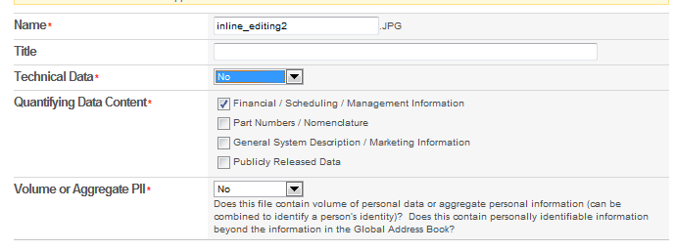
Document classification
There’s no good way to turn classification on for all documents
Don’t modify the out of the box Document Content Type!
Consider leveraging unique Content Types

Slide 40
Training & Communication
Executive sponsorship is crucial if the security model is painful
Tailor your adoption training to include security model restrictions
Ramp up a core base of power users to be your ambassadors
Partner with communications to get the message out

Slide 41
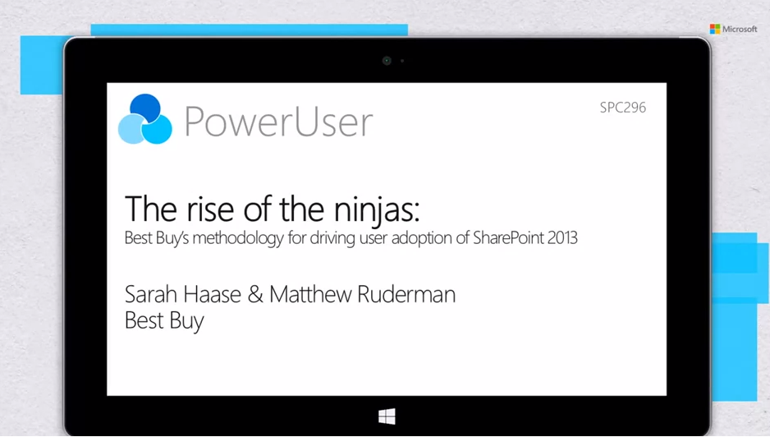
Recommended adoption session!
http://channel9.msdn.com/Events/SharePoint-Conference/2014/SPC296

Slide 42
Summary

Slide 43
In closing..
SharePoint Security is difficult but there are options
Prototype with simple solutions but always test for scale
Communication & training plans are the keys to success
Don’t be afraid of process improvement
They did name it SharePoint for a reason

